Slide 1
The Basics

Slide 2
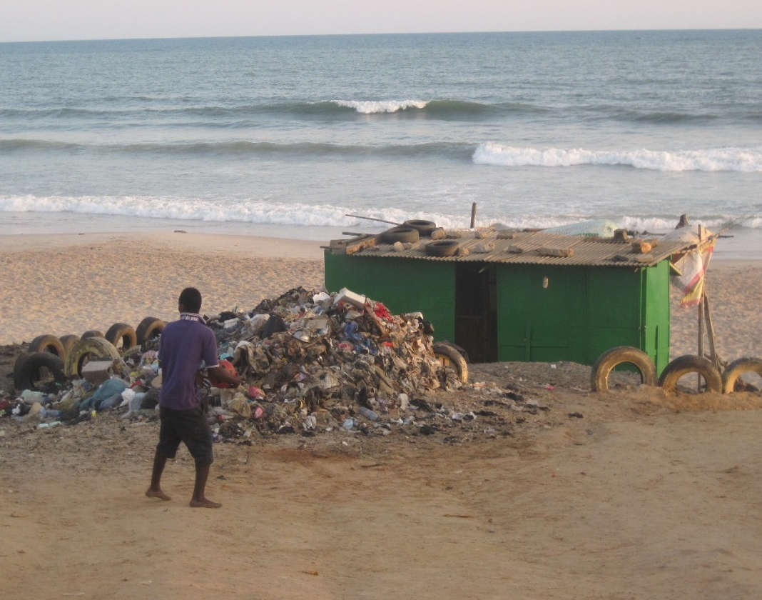
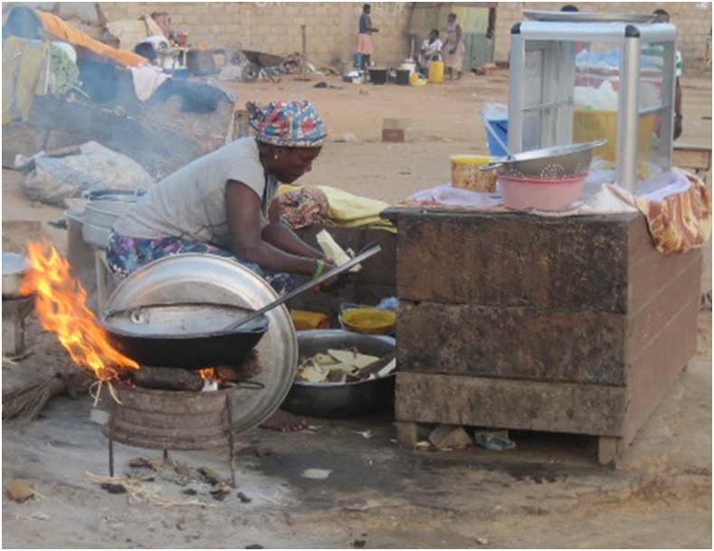
The State of Things
By 2050, need 60% more food
20% no electricity
35% no plumbing
Waste→
http://web.worldbank.org/WBSITE/EXTERNAL/TOPICS/EXTENERGY2/0,,contentMDK:22855502~pagePK:210058~piPK:210062~theSitePK:4114200,00.html; http://www.economist.com/news/united-states/21610323-barack-obamas-ambitions-africa-will-be-measure-american-engagement
http://www.who.int/water_sanitation_health/mdg1/en/
http://www.unwater.org/water-cooperation-2013/water-cooperation/facts-and-figures/en/
http://www.epa.gov/epawaste/nonhaz/municipal/

Slide 3
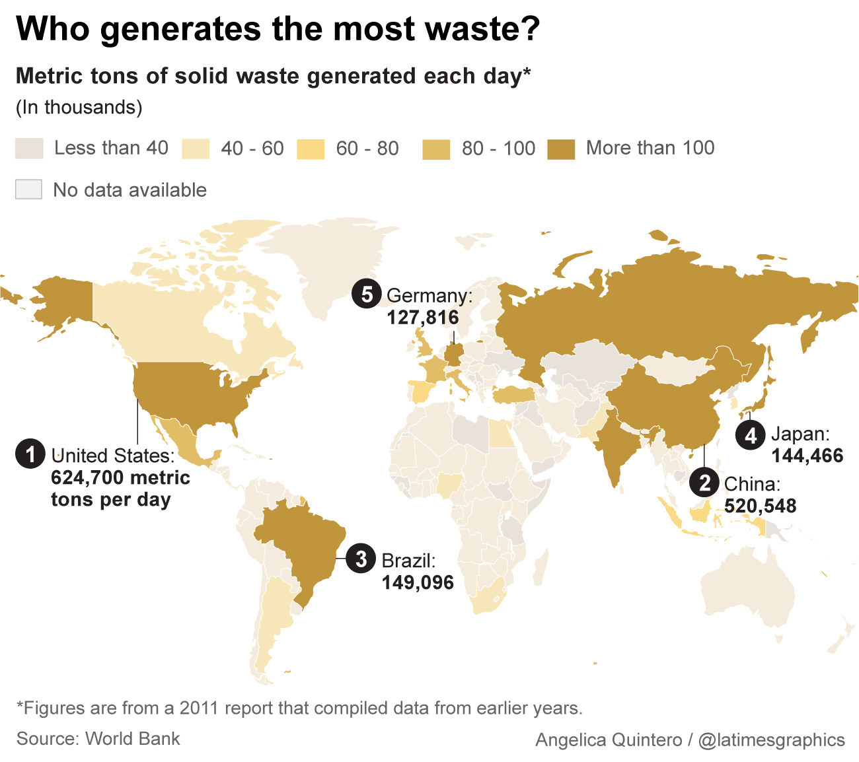
http://www.latimes.com/world/global-development/la-fg-global-trash-20160422-20160421-snap-htmlstory.html

Slide 4
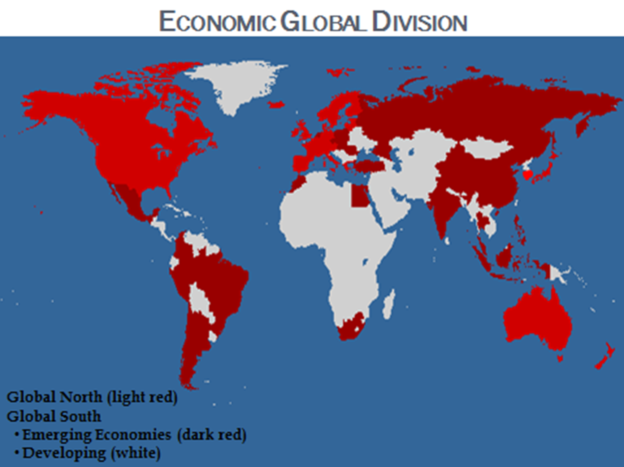
Global Economic Divide

Slide 5
A Few Terms
States (a.k.a. countries)
Secure system
Intergovernmental Organizations (IGOs)
United Nations (UN), World Trade Organization (WTO),
Nongovernmental Organizations (NGOs)
Global to local (aka non-profits, grass-roots)
Fairtrade Int’l (FLO), Ten Thousand Villages
Multinational corporations (MNCs)
Transnational issues
Aspects: political, economic, sociocultural, security (people and planet)

Slide 6
Local to Global Chain
You
Retailers
Independent, national, MNCs
Manufacturers
Independent, national, MNCs, countries
Sources of goods
Producers
Growers
Artisans
Processers
Recyclers
Buyers, Traders
Exporters
Shippers

Slide 7
About Sustainability

Slide 8
Sustainability
Sustainable development
Growth w/o env. damage
Sustainability
Development that also improves quality of life
For producers, communities
Tied to globalization
Neoliberal economic model (NEM)
Capitalism
Race to the bottom
GN, GS affected, responsible
¤

Slide 9
Consumption & Sustainability
Tuberculosis
Overuse of materials
Consumerism
30% overconsume more than is sustainable
44% countries exceed bio-capacities
Not all GN
¤

Slide 10
Commodity Fetishism
Real value v. perceived value of a product
Real value = human labor
Real value obscured
Price, brand v. generic, healthfulness
Don’t consider source of product
Perceived value = what product can do for buyer
Satisfy need, accord social stature, assuage guilt, promote health, save them time/money, etc.
Value-added products
Not just oats, but Quaker Oats
Not just a smart phone, but an iPhone
¤

Slide 11
Commodity Fetishism Problems
Producer not vested in end product
Consumer not vested in producer
Hidden costs behind product
Externalities
Human, env. damage, not in purchase price
Assigning value
NEM: market decides
Critics: should consider externalities
Everyone caught in capitalist net
Earn more money, buy more stuff
System sets rules in its favor
¤

Slide 12
Credit Cards

Slide 13
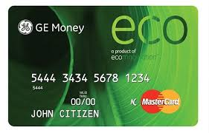
How does the rise of the credit card undermine sustainability? (WA Q1)
Facilitates overconsumption
Lose sight of ‘value’
Eco-conscious CCs as oxymoron
Materially unsustainable
Disposability
‘Inflationary culture’
☼
http://l.yimg.com/a/feeds/us/grn/Green_Graffiti/2920424620103830173S600x600Q85.jpg

Slide 14
Why is whether plastic can be green (i.e. ‘green plastic’) up for debate? (WA Q2)
What it’s made of
Bioplastics v. petro-plastics
Non/renewable resources
Using crop space?
Petro- from fossil fuel processing waste
Life-cycle of plastic waste
Biodegradability
Need new infrastructure for bioplastics
Cost factor
For production, disposal
What does ‘biodegradable’ really mean?
☼

Slide 15
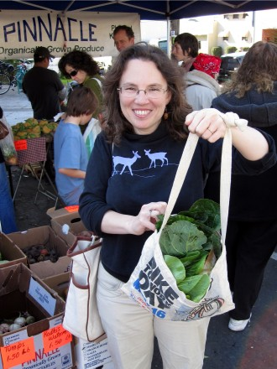
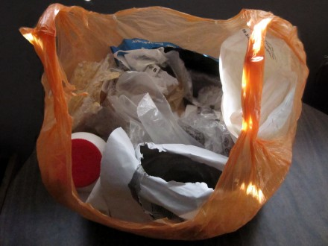
Meet Beth Terry: Plastic Purger
What did you learn from her experience of trying to forgo plastic?
Plastic Waste for 2011
https://myplasticfreelife.com/press-kit/

Slide 16
Why are MNCs’ “sustainability” policies more aptly described as “efficiency” policies? (WA Q3)
Diverse schemes
Actual env., social impact
Cost saving, compliance → Higher profits and stock valuation
Good PR
Unilever
☼

Slide 17
Recap
Sustainable development v. sustainability
Consumption
Plastic’s contributions
The credit card’s role
…Then the debit card follows
Commodity fetishism
Issues with sustainability practices
☼

