Slide 1
The Future: Degrowth & Sustainability

Slide 2
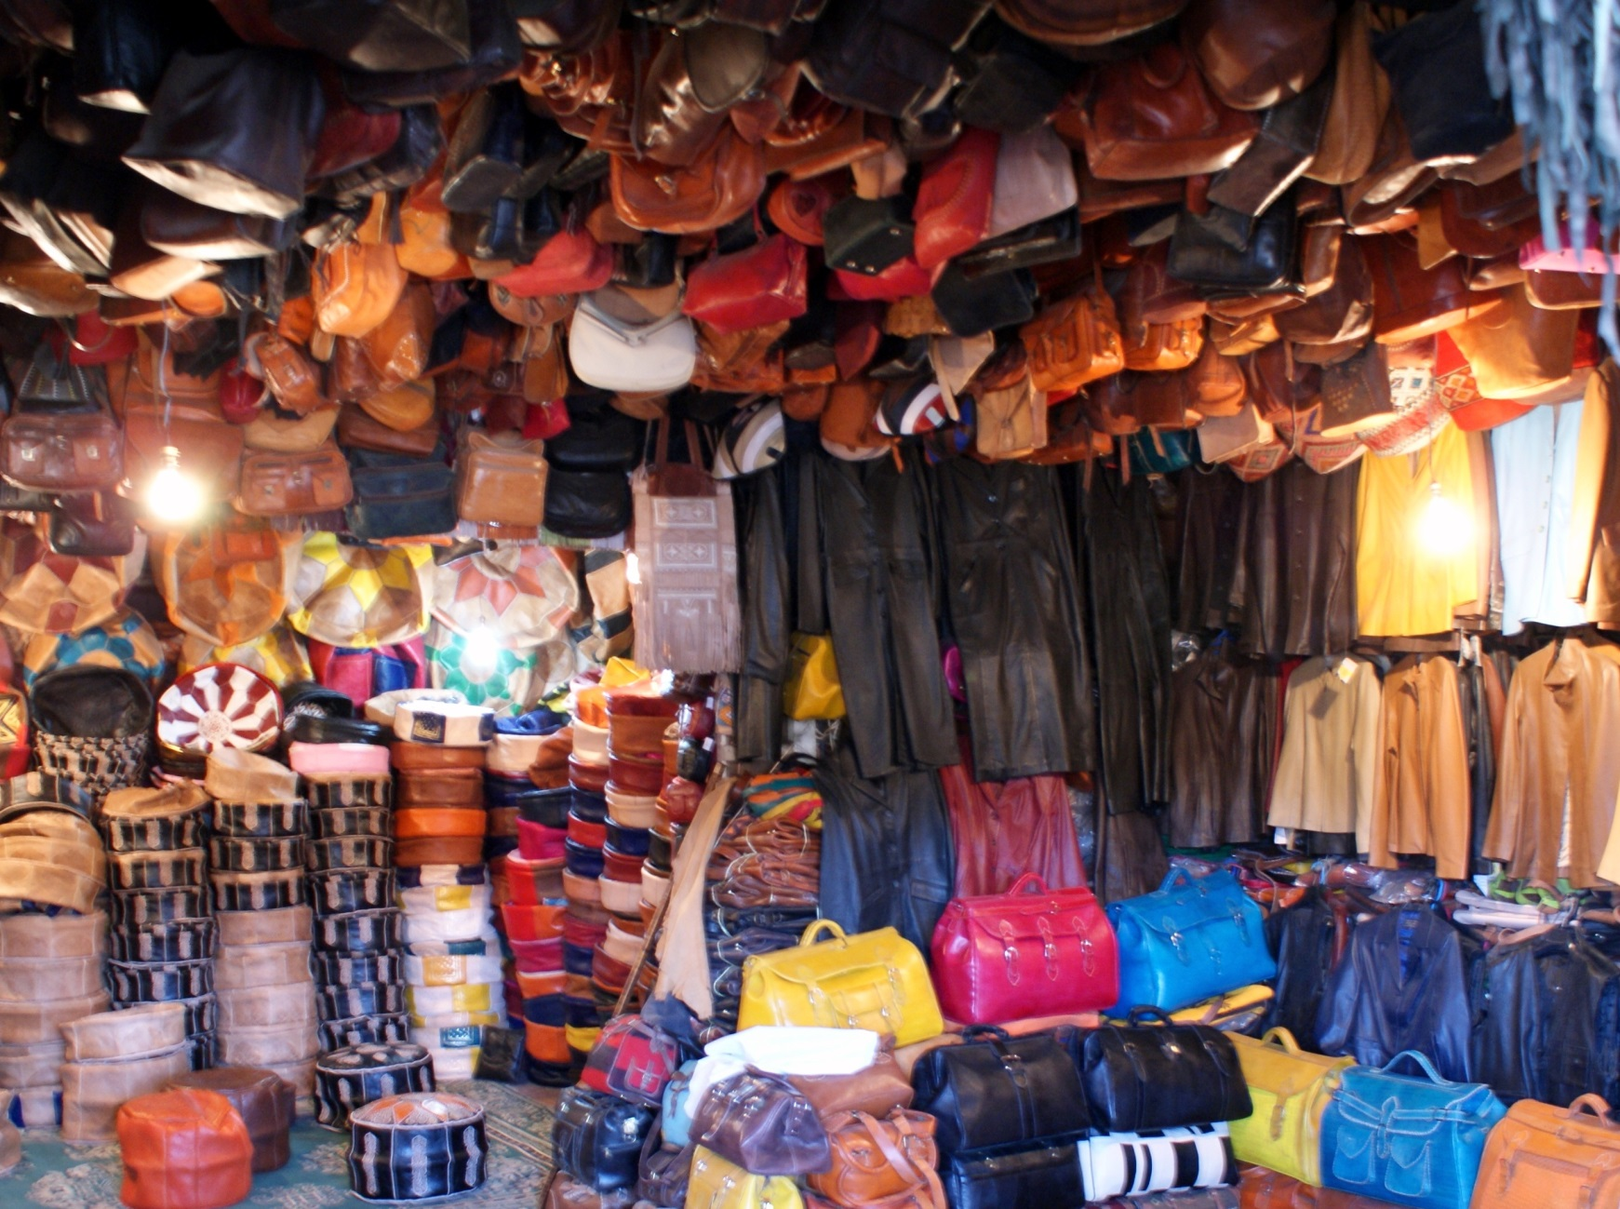
Black Friday, the NEM, & Commodity Fetishism
(WA Q1)
‘A frenzied explosion of consumer culture’

Slide 3
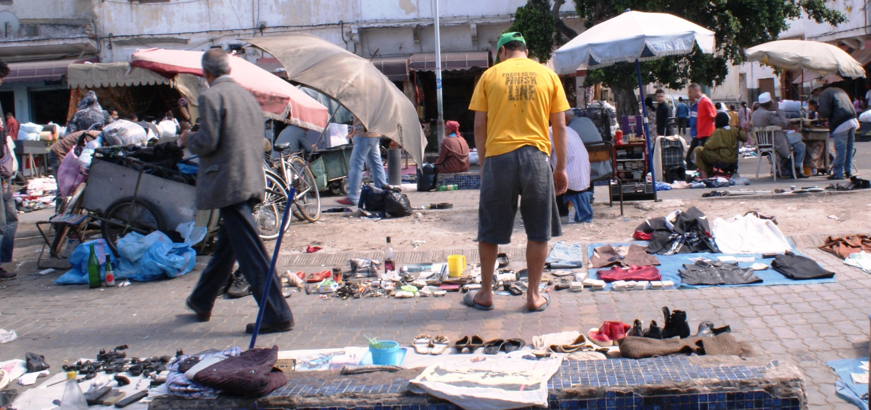
Black Friday, the NEM, & Commodity Fetishism
(WA Q1 cont.)
‘A frenzied explosion of consumer culture’
Huge #s
Aggression, violence, deaths
Getting worse
Cyber Monday
The Clash
¤

Slide 4
Black Friday, the NEM, & Commodity Fetishism
(WA Q1- cont.)
‘Capitalism req. growth
CF= guise of ‘consumer power’
Retail therapy
Adverse feedback loops
Ignore external costs
CF thrives on:
Consumer apathy
Feeling overwhelmed if want to help
Halo effect
Lack of ed.
¤

Slide 5
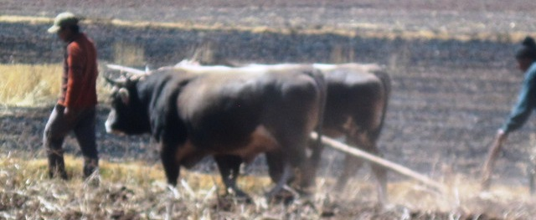
Why is ‘degrowth’ argued as a necessary step beyond SD? (WA Q2)
Degrowth advocates
Scale back production, consumption
Eliminate social injustices
Redefine ‘the good life’
GN living in post-materialism era
Same concerns as CF
¤

Slide 6
Why is ‘degrowth’ argued as a necessary step beyond SD? (WA Q2 cont.)
SD co-opted by MNCs
SD implies development
Needed in GS, but need to avoid GN model
No-growth advocates
¤

Slide 7
How to/what will/what can successfully challenge the dominant paradigm? (WA Q3)
Shift in values
Is FT cocaine the answer?
‘Importance of scale’
Replace sustainability
Planned obsolescence
Need policy changes
¤

Slide 8
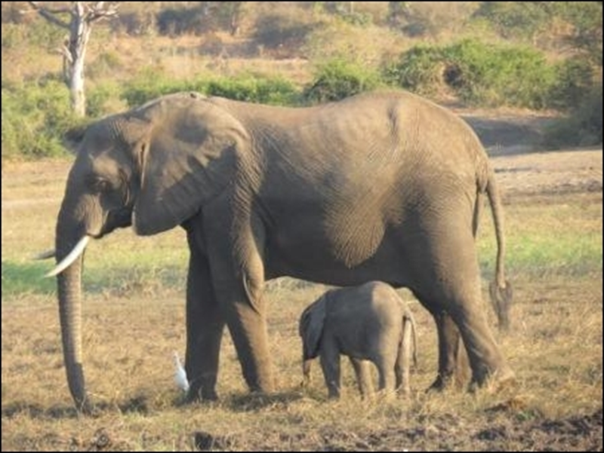
Recap
SD co-opted by MNCs
Degrowth = sustainable progress
Borrowing into future
Challenges capitalism, CF
Pushes for a balance
Consumption, work hours, equal access
Need to make changes
What we value
‘True materialism’
¤

