Slide 1
About Fair Trade

Slide 2
What is Fair Trade?
Fair price, conditions for producers
Pushes for social justice
FT to bypass capitalist system
Potential value in capitalist system
Greater reach
Split within FT mvt.
FTUSA v. FLO
¤

Slide 3
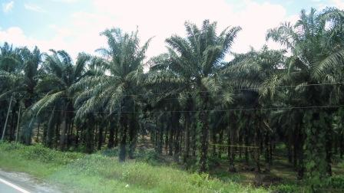
How does the capitalist system promote GS poverty through commodity exchanges? (WA Q1)
Producers are ‘global subjects’
Race to the bottom
Inequality, poverty → ecological ruin
Resource exploitation is extensive
NEM: Need more integration
Critics: Capitalism is the problem
¤

Slide 4
How did the FT mvt. shift from one based on charity, instead to a focus of equality and promoting “trade not ‘aid’” as equal exchange? (WA Q2)

Slide 5
Fair Trade History
Then
Informal
Alternative to capitalist system
Network-, trust-based
Charity affiliation, charity model
Mostly churches
Sought social justice through religion, solidarity, charity
FT orgs.
Now
Formal
Dual: within and outside system
Mostly impersonal
Sell stories to appeal to buyers
Equal-exchange model
Much more secularized
Social justice through ‘trade not aid’
Driven by not only social justice, but social status
FT labels and FTOs

Slide 6
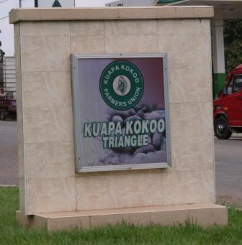
How does the MNC approach to FT cause tensions? (WA Q3)
Trad.: work outside NEM
Radicals: break down NEM
Pragmatists: use NEM to expand reach
MNCs: use FT demand for own growth
Reinforces NEM
= dilemma
¤
What are the pros and cons of fair trade?
→consider the macro and micro perspectives from the article, along with other reading

Slide 7
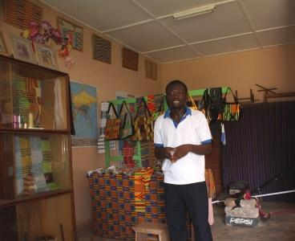
Pros of Fair Trade
Traditional model:
Fair wages
Community investment
Infrastructure
Social welfare projects
Governance
Training
Promotes env. policies
Promotes sustainability
‘Trade not aid model’
¤

Slide 8
Pros of Fair Trade
Mainstream FTOs Add:
GS majority-owned
Mass distribution
↑ product sales→↓ less shelf time
↑ FT exposure
MNCs add:
↑ awareness
↑ consumer base
↑ market access
Secularized
↓ chance of poverty
Mkt should reward FT production
¤

Slide 9
Cons of Fair Trade
Traditional model:
Small reach
Issues w/ MNCs:
Competition to trad. model
Manipulate rules:
Co-opt process
Regulations
FT reputation
Pricing diff.
Social premiums
Contracts
Traceability
Financing
Democracy
Competition
Global value chains
↓ producer involvement
Causes tensions w/ trad.
Fair-washing
MNCs’ products dominate mkt
Growth is always objective
¤

Slide 10
Recap
FT objectives
Improve producers’ lives
Sustainability
FT provides $ transfer from GN to GS
System sets rules in its favor
NGOs→ labeling
Concern is end product, not effects of production
Regulate only if consumer problem, not production-end issue (env., health of laborer)
Can political consumerism effect change?
Race to the bottom discourages ‘fair’ compensation
Need to remain competitive
Use market but don’t get consumed by it
¤

