Slide 1
Conventional v. Organic and Local Food

Slide 2
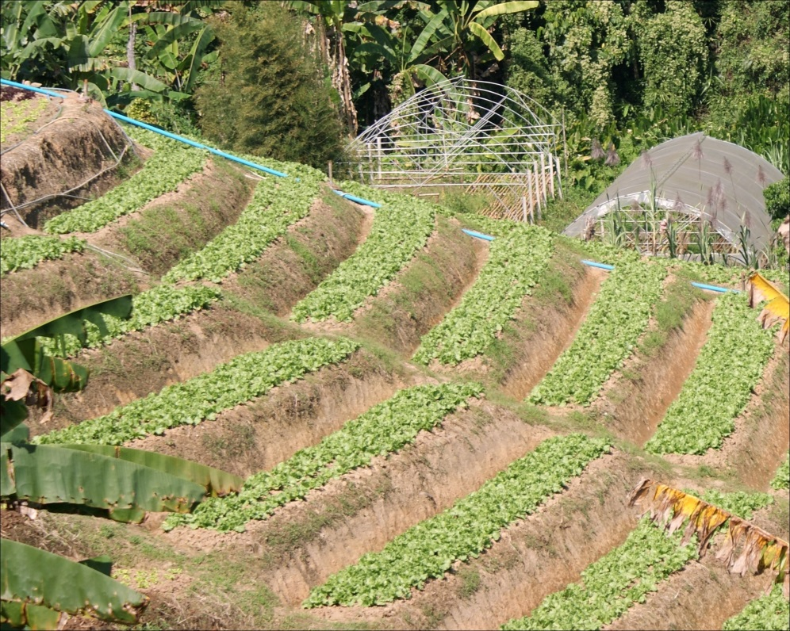
How do conventional, GMO methods of farming promote sustainability? (WA Q1)
Promote food security by adapting seeds
Very few never adapted
Green Revolution due to GMOs
Req. less land
↑ Resistant to diseases, etc.
Need fewer ag. inputs
Increases efficiency
No known ill health effects
GMOs more regulated
¤

Slide 3
What are the main contributing factors to the organics movement? (WA Q2)
Distrust of MNCs
Not transparent
Exploit GS
Human health
Consumers
Workers
Environmental
Super weeds, pest problems
Monocropping
Product of political culture
¤

Slide 4
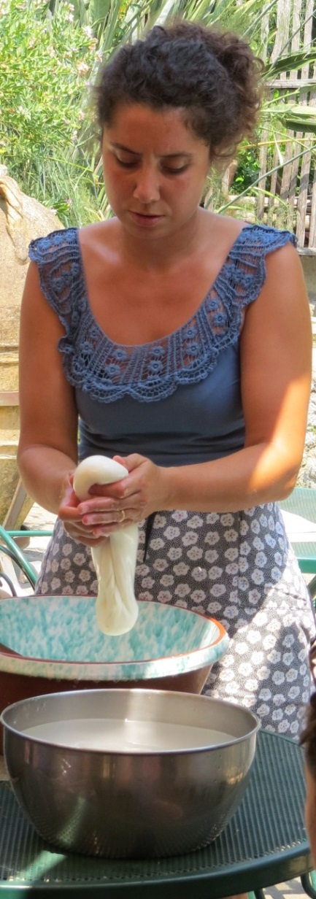
What issues do both the organic and local food movements attempt to address? (WA 2 and 3)
Large-scale production
Critical of MNCs
Want natural products
Push eating locally
Local esp. like early ATO FT
Commodity fetishism
Push slow food movement
Food security
Don’t see global implications
¤

Slide 5
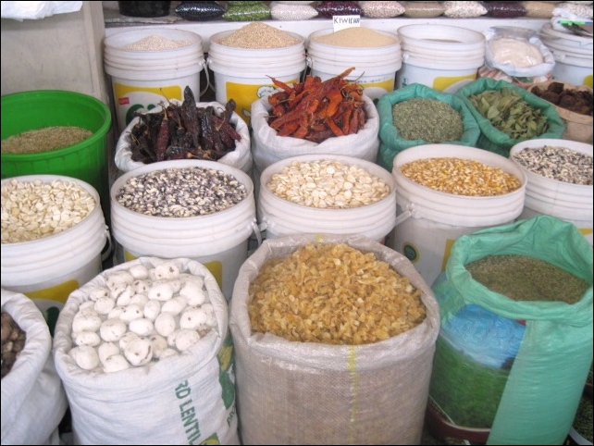
What problems do they both encounter? (WA 2 and 3)
Would req. radical dietary changes
Local/organic ≠ sustainable
Not viable on large-scale
Mass production more efficient
GMOs more often productive
Organic ≠ natural, non-toxic, or safer
Bigger problem in U.S. - inadequate amount of produce
Contribute to commodity fetishism
Tied to social status
Disadvantages poor’s food security
In GN who can’t afford produce, let alone organic
In GS, farmers who dependent on ag exports
¤

Slide 6
Food Diversity
Why promote food diversity?
Local cuts off small farmers
Reliance on few crops problematic
Increases plant vulnerability
Need more ag. inputs
Ship globally
GS too reliant on imports over local crops
¤

Slide 7
Recap
Conventional
Gl. food security
Less land, better yields, few ag. inputs, etc.
Expose workers
Monocropping
Organic
Own health concerns
Requires ↑ resources for ↓ yields
Lack evidence that it’s better
Bottom line- organic can’t feed population
¤

Slide 8
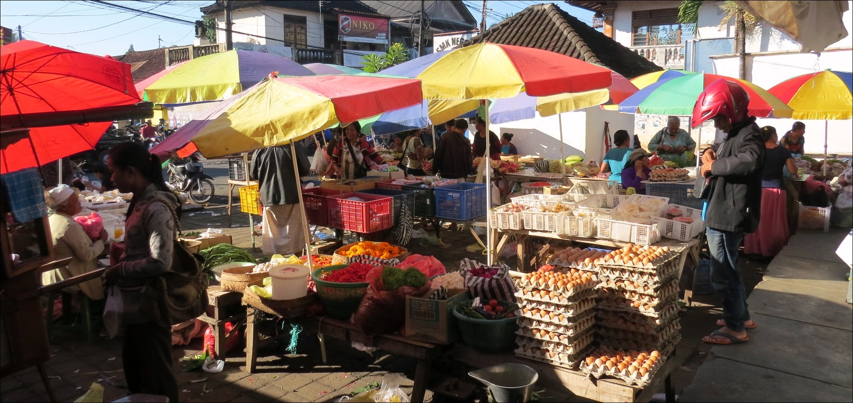
Recap (cont.)
Local food
GN-severely limit diets; discriminates against GN, GS poor
GS-diets more local, but still rely on imports
Could promote food diversity in GS
¤

