Slide 1
Plastic Bags or, to some, The Spawn of Satan

Slide 2
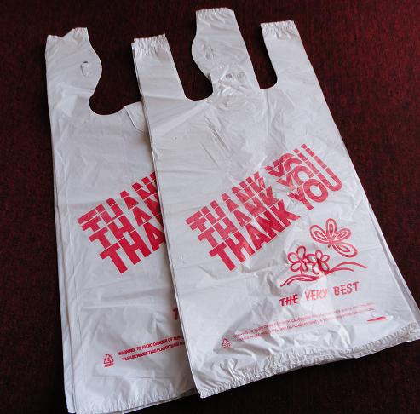
Why is just banning bags unlikely to promote sust.? (WA Q1)
Just switch to paper
Far less efficient
More expensive
Harsher on env.
Deforestation, pollution, etc.
Plastic = convenient, disposable→ set precedent
Just a small % of total waste
But very damaging
¤

Slide 3
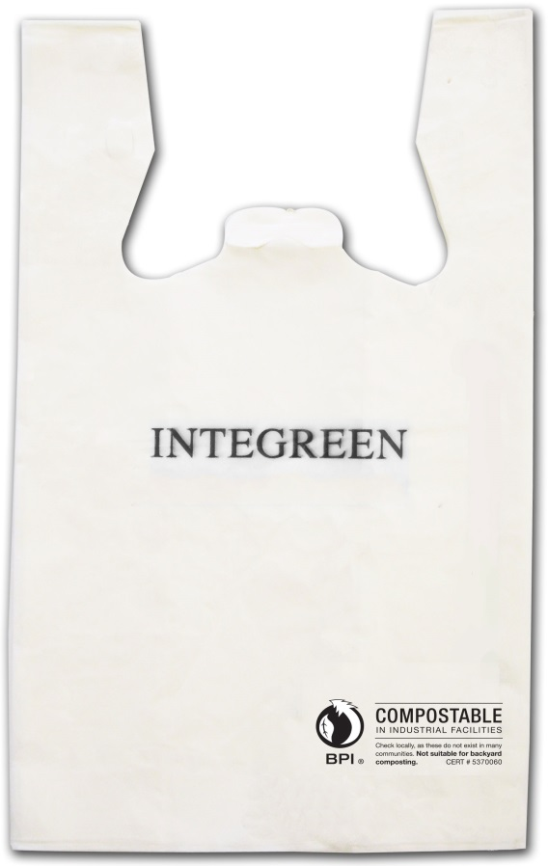
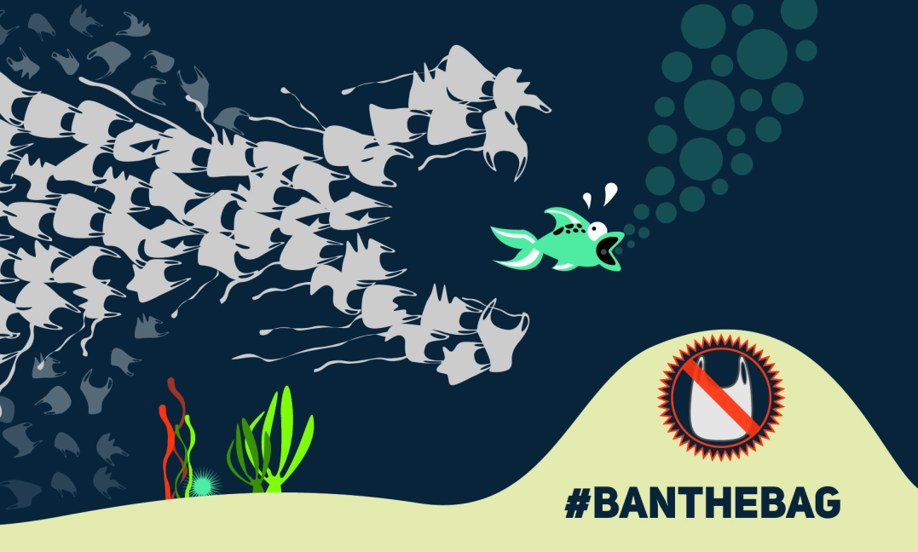
How are plastic bags so damaging?
Rely on non-renewable resources
Not efficient for recycling
Get stuck in recycling machinery
Litter →sewer drains→ water supplies→ oceans
Harmful to fauna
Long time to decompose
Biodegradable need ideal conditions
Use landfill space
¤
http://www.surfrider.eu/en/the-ban-of-plastic-bags-in-france-postponed-for-three-months/

Slide 4
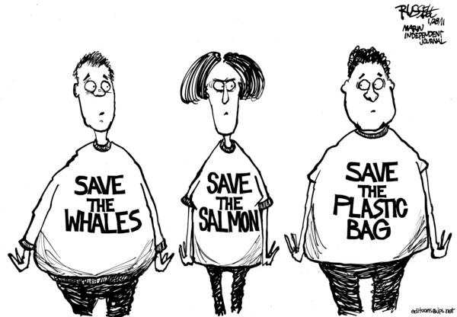
What issues interfere with banning plastic bags? (WA Q2)
People expect bags
Convenience
Labeled as ‘tax’
Hurts ‘those who can least afford it’
Cost less to produce, transport than paper
Local v. state gov’t policies
Pro-plastic bag advocates strategize
ACC to promote plastics
Offer biodegradable
Set up recycling
Lawsuits
¤
http://extras.mnginteractive.com/live/media/site234/2011/0128/20110128__webtoon130bags.jpg

Slide 5
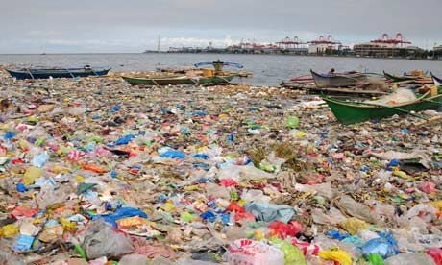
What needs to happen to address the bag issue?
Make single-use bags socially unacceptable
Offer incentives
Taxes, rewards
Have reusable bags available for purchase or free
Appeal to status
Focus on big cities
Consumer education
Counter ACC’s push
¤
Manila Bay, Philippines

Slide 6
In what ways do plastics used in farming challenge sustainability? (WA Q3)
Need crops
Heavily reliant on plastics
Diff. in collecting, recycling these plastics
Fear contaminants and pathogens
Lack after-market
Lack organized means to collect
Env. trade-off
Save water, grow organics, ‘perfect’ produce
¤

Slide 7
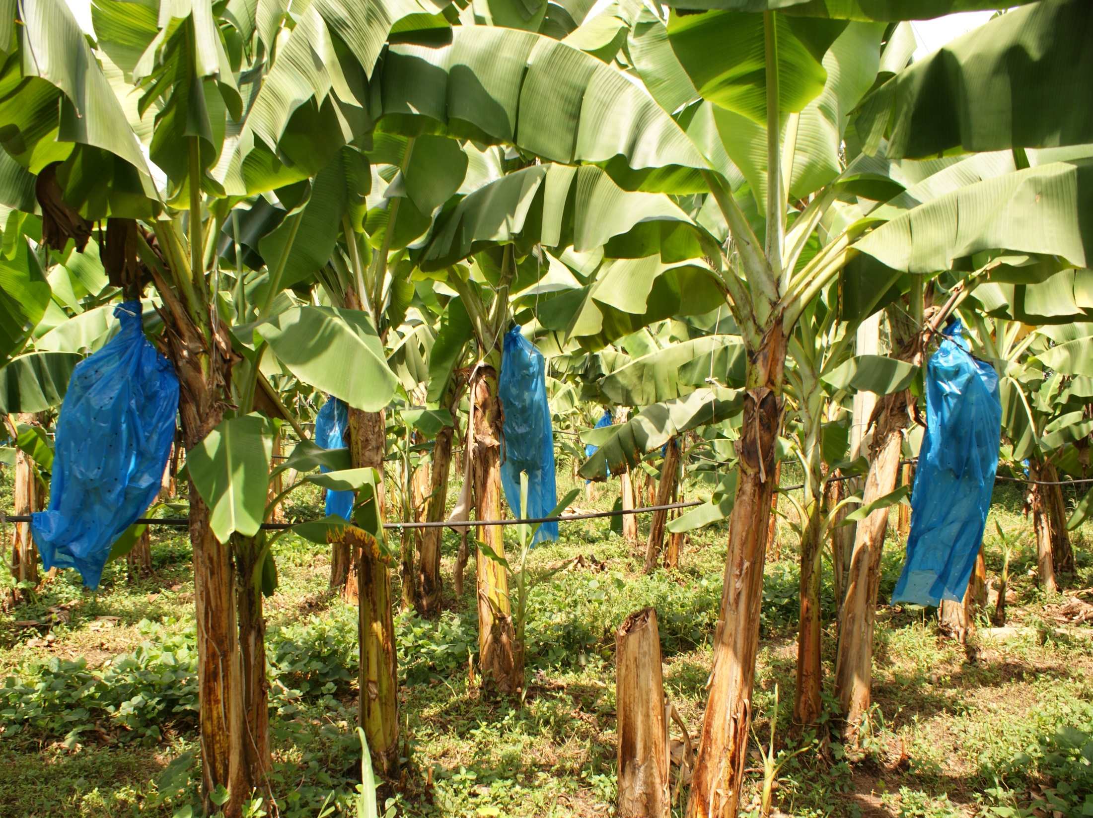

Slide 8
Recap
Consumer ed. key to raising awareness
ACC’s bigger concern- outcry against disposables
Targeting plastic bags= ‘low hanging fruit’
Won’t significantly diminish quality of life; easy to do
Plastic bags incur excess indirect costs
Plastic bags are indicative of consumer culture, commodity fetishism
¤

