Slide 1
Serendipalm
Dr. Bronner’s Magic Soap Company
Wanted sustainable source
Joined with Fearless Planet, an NGO
Helped found Serendipalm Co. Ltd. (2006)
Asuom, Ghana (i.e. middle of nowhere)
Largest palm oil FTO in world
¤

Slide 2
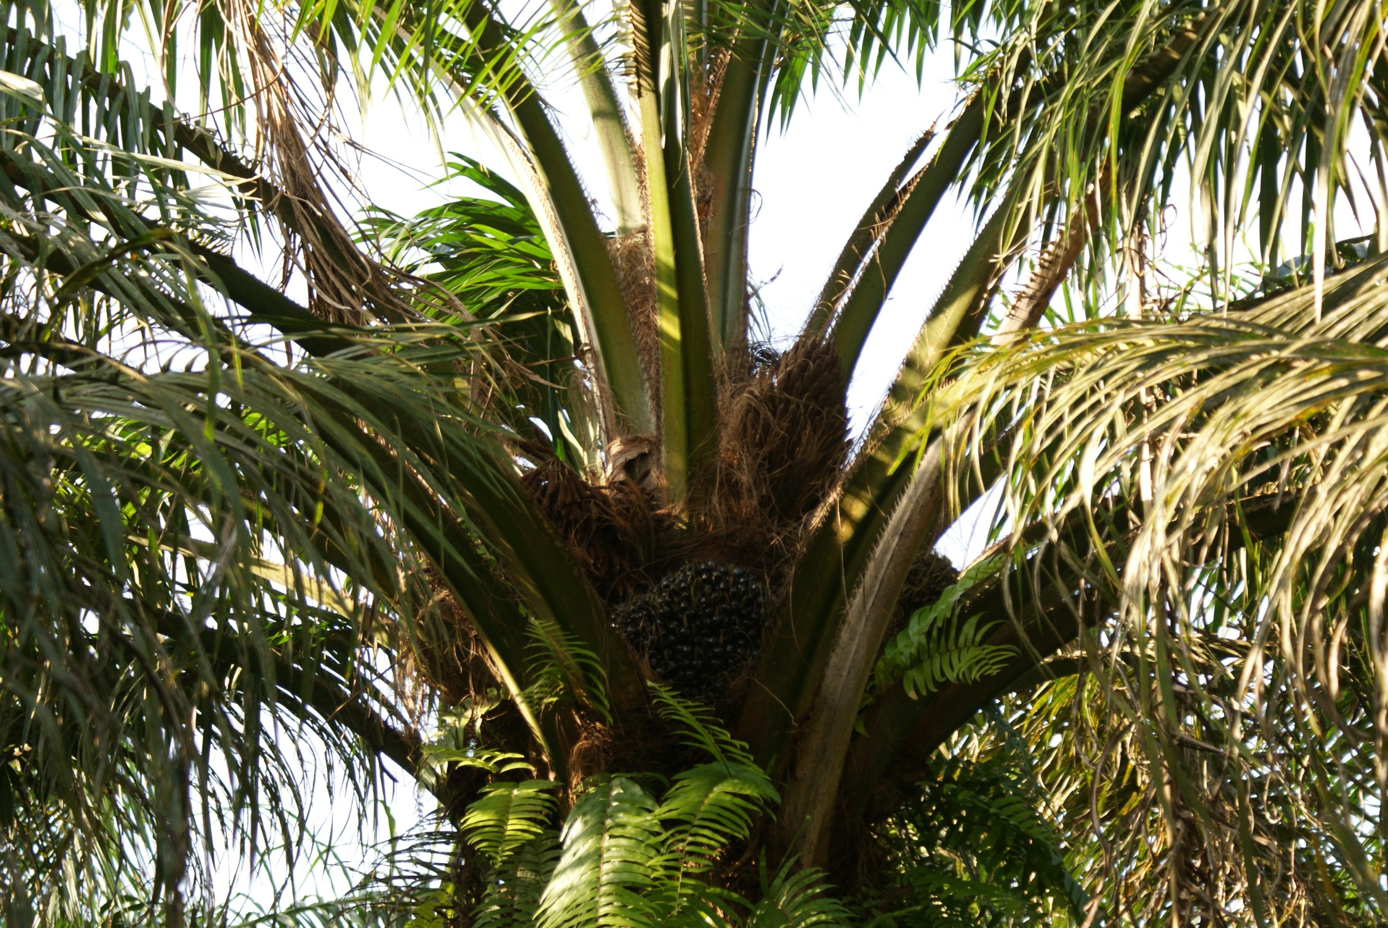

Slide 3
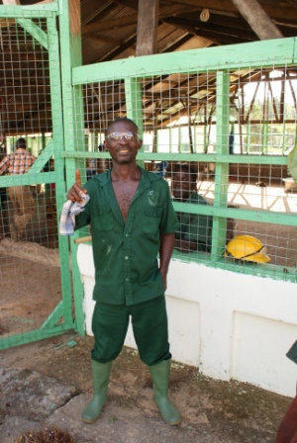

Slide 4
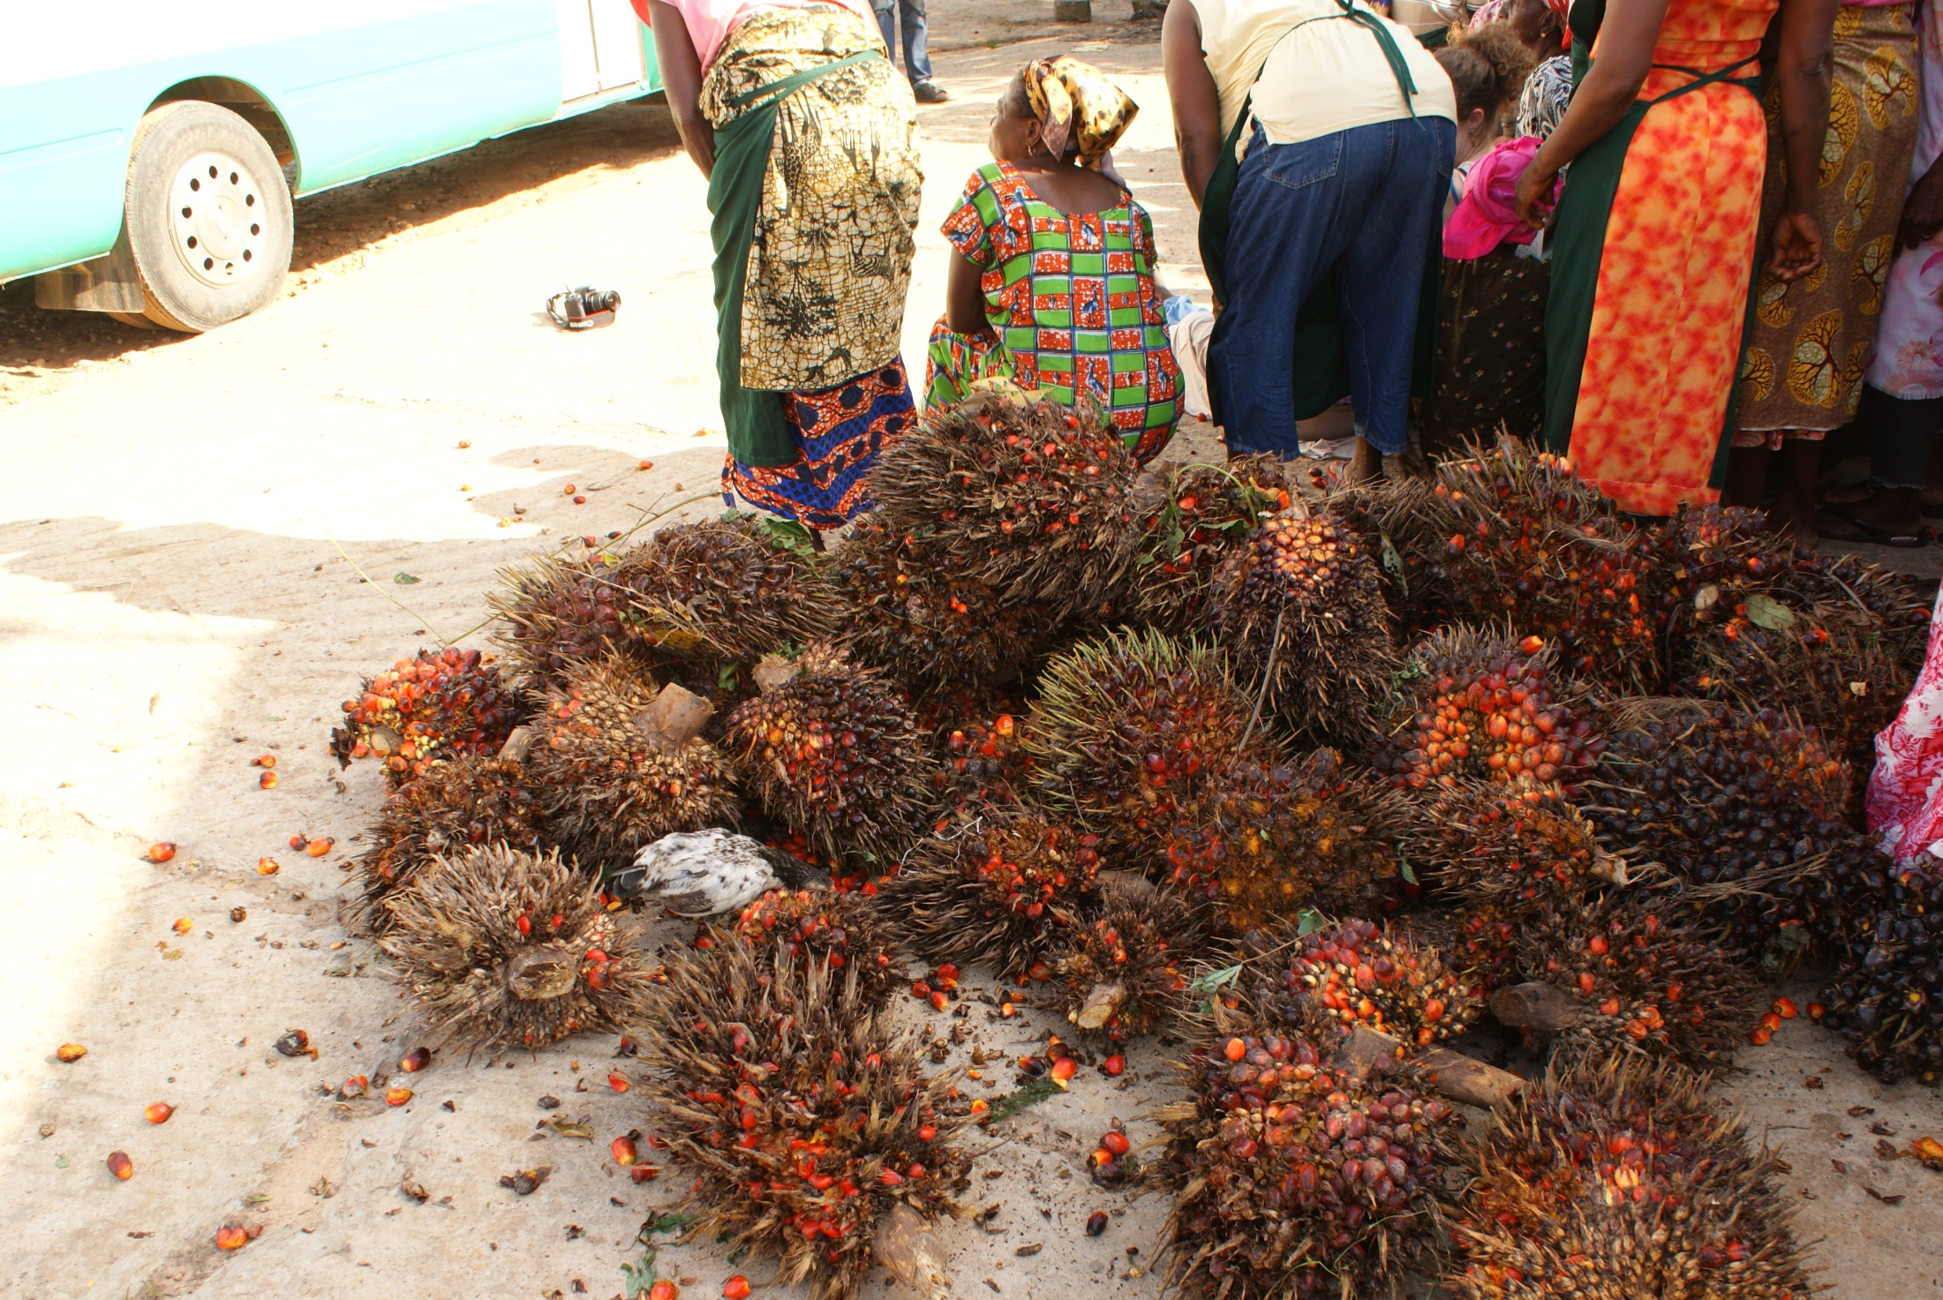

Slide 5
Serendipalm
Processing plant
~200 workers
Buy from 670+ families in region
Pay fair price and organic premium
Offer supports
Agricultural inputs
Training
Largest local employer in region
¤

Slide 6
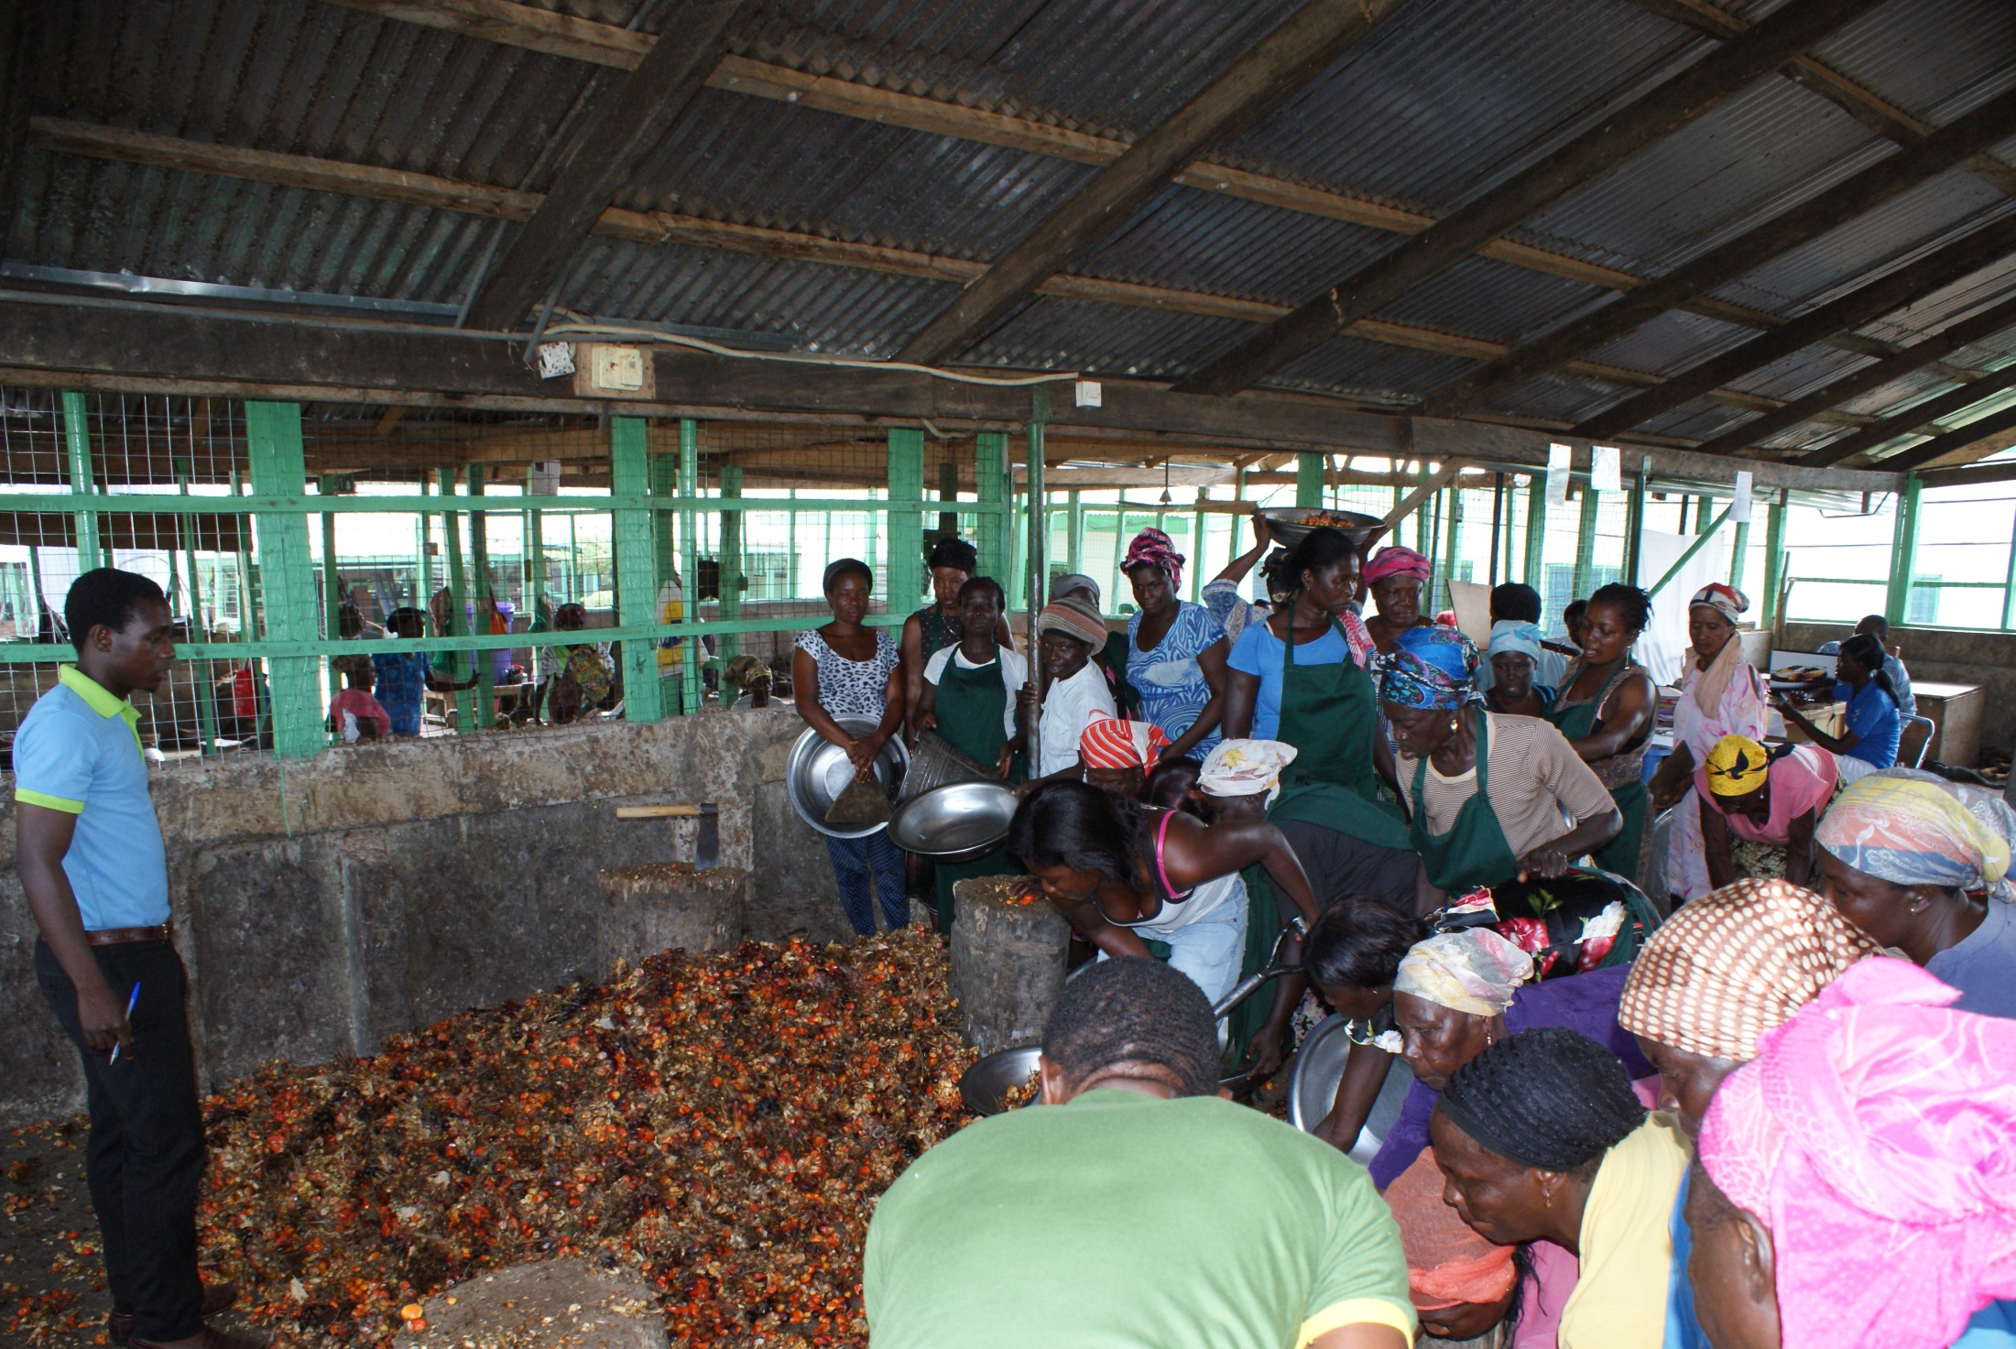

Slide 7
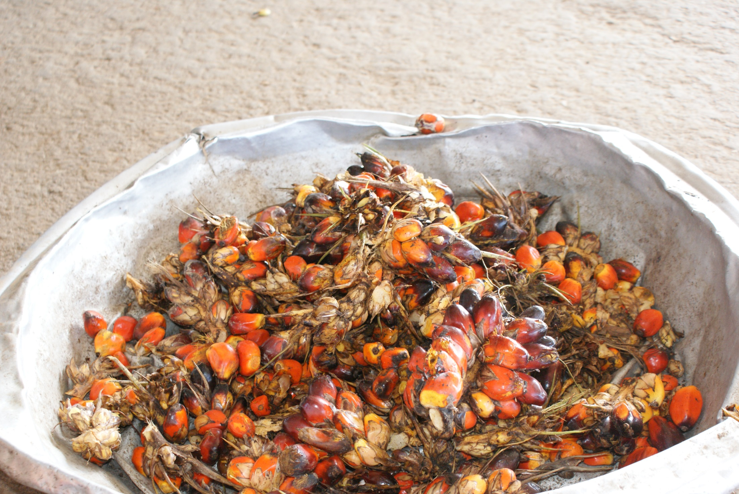

Slide 9
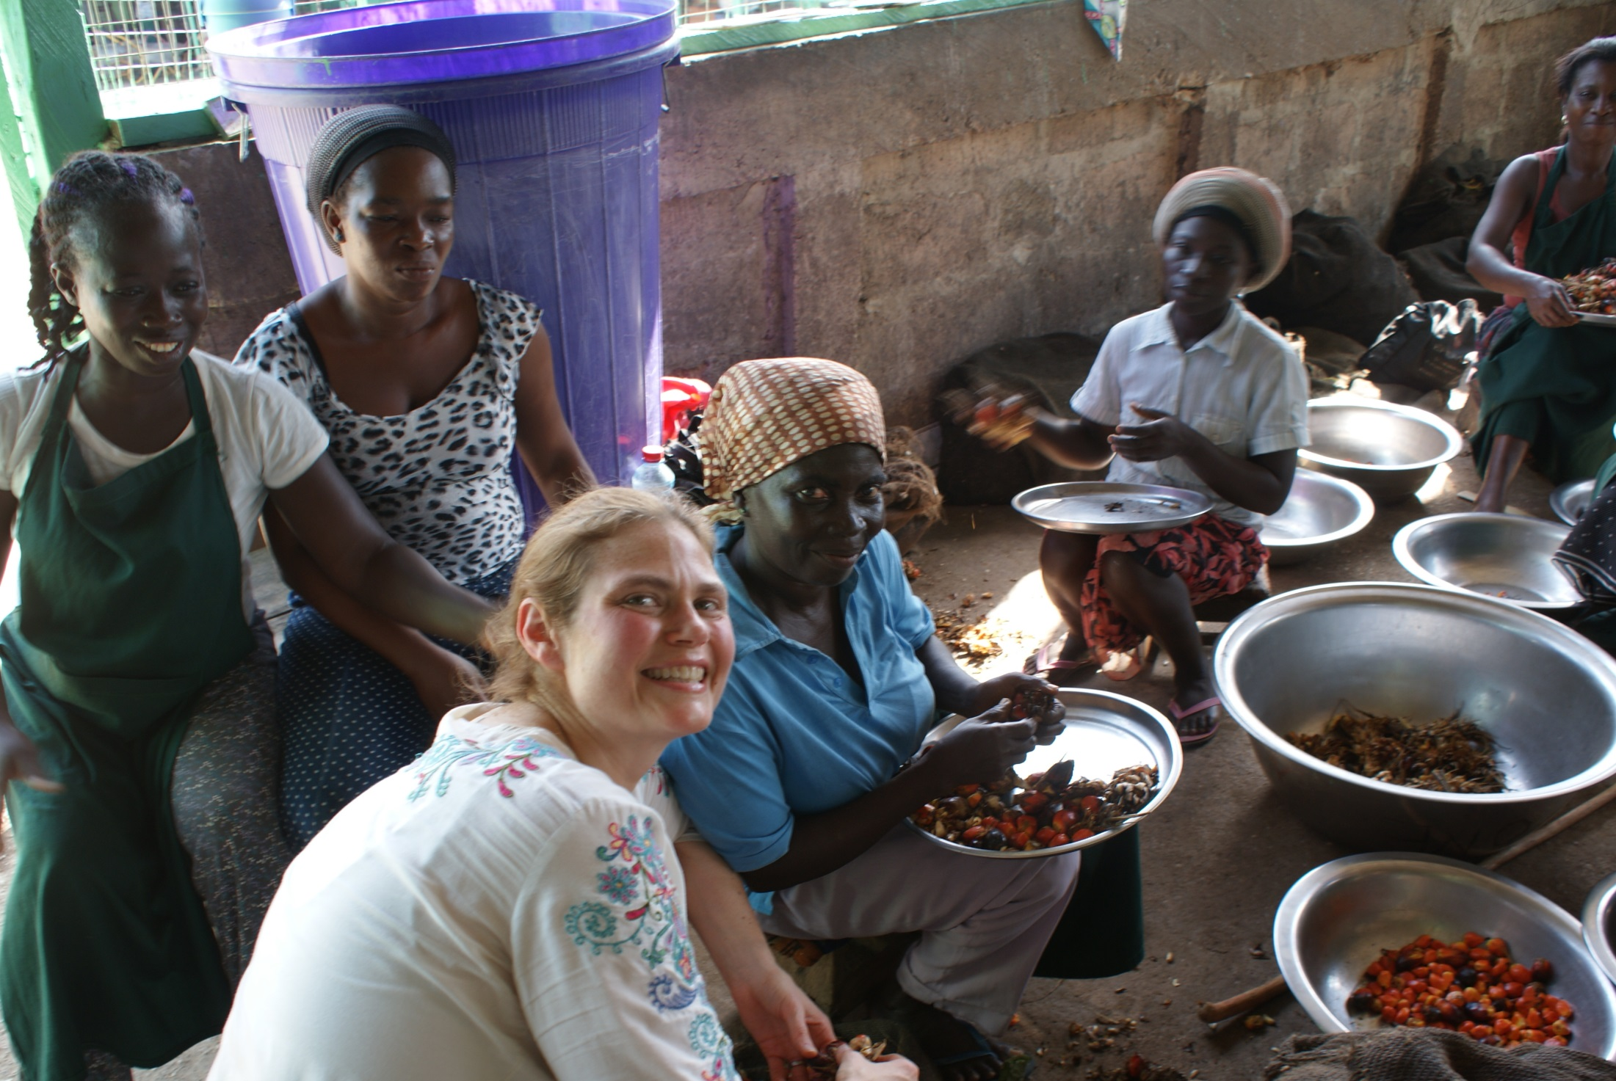

Slide 10
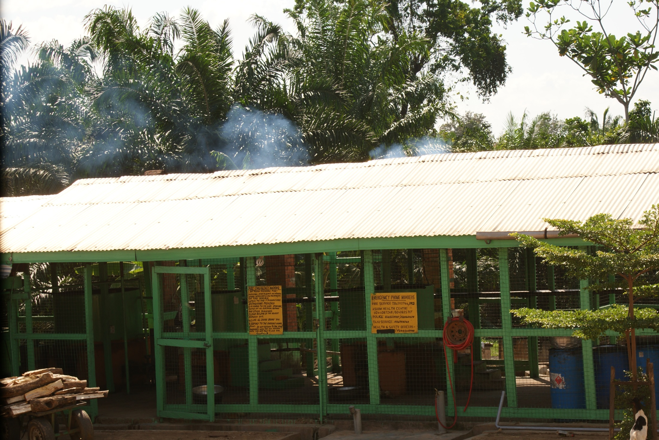

Slide 11
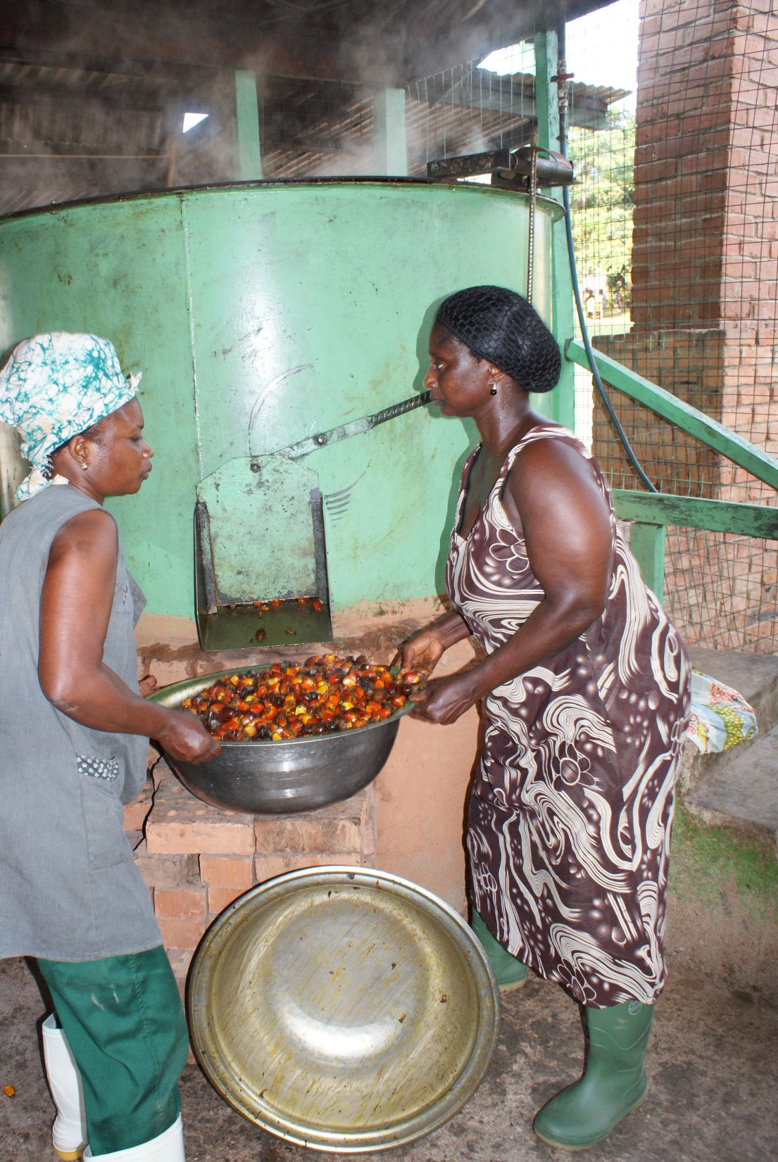

Slide 12
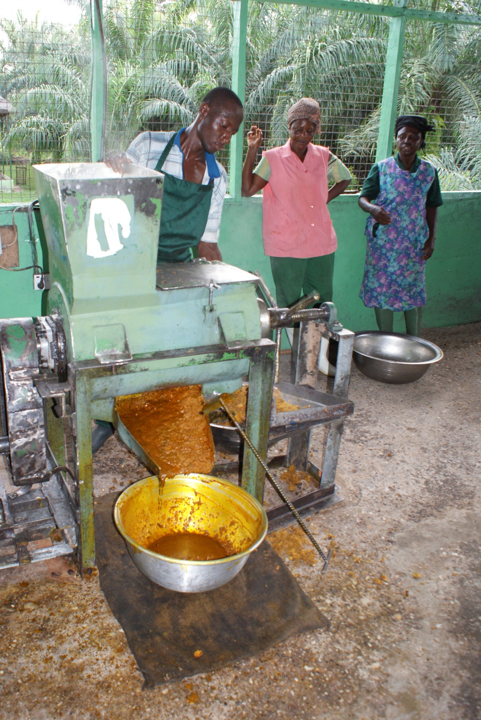

Slide 13
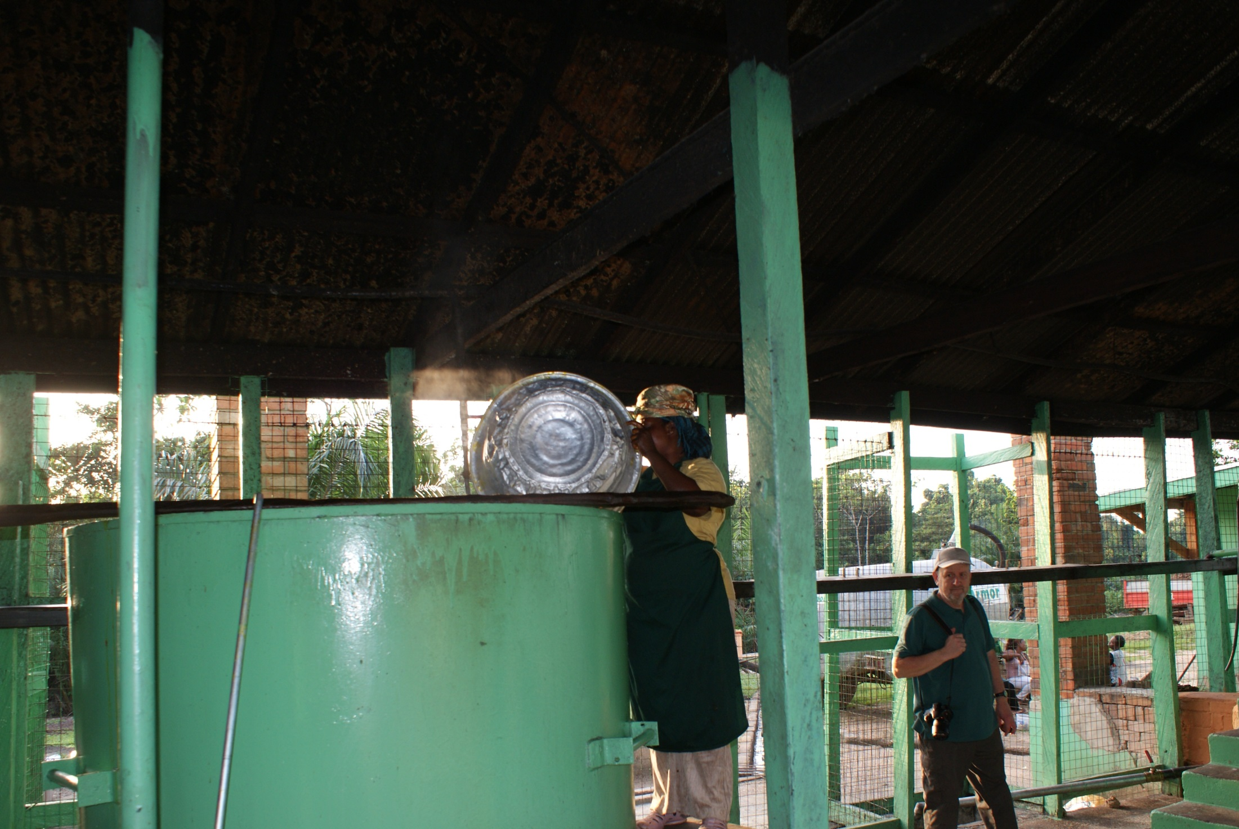

Slide 14
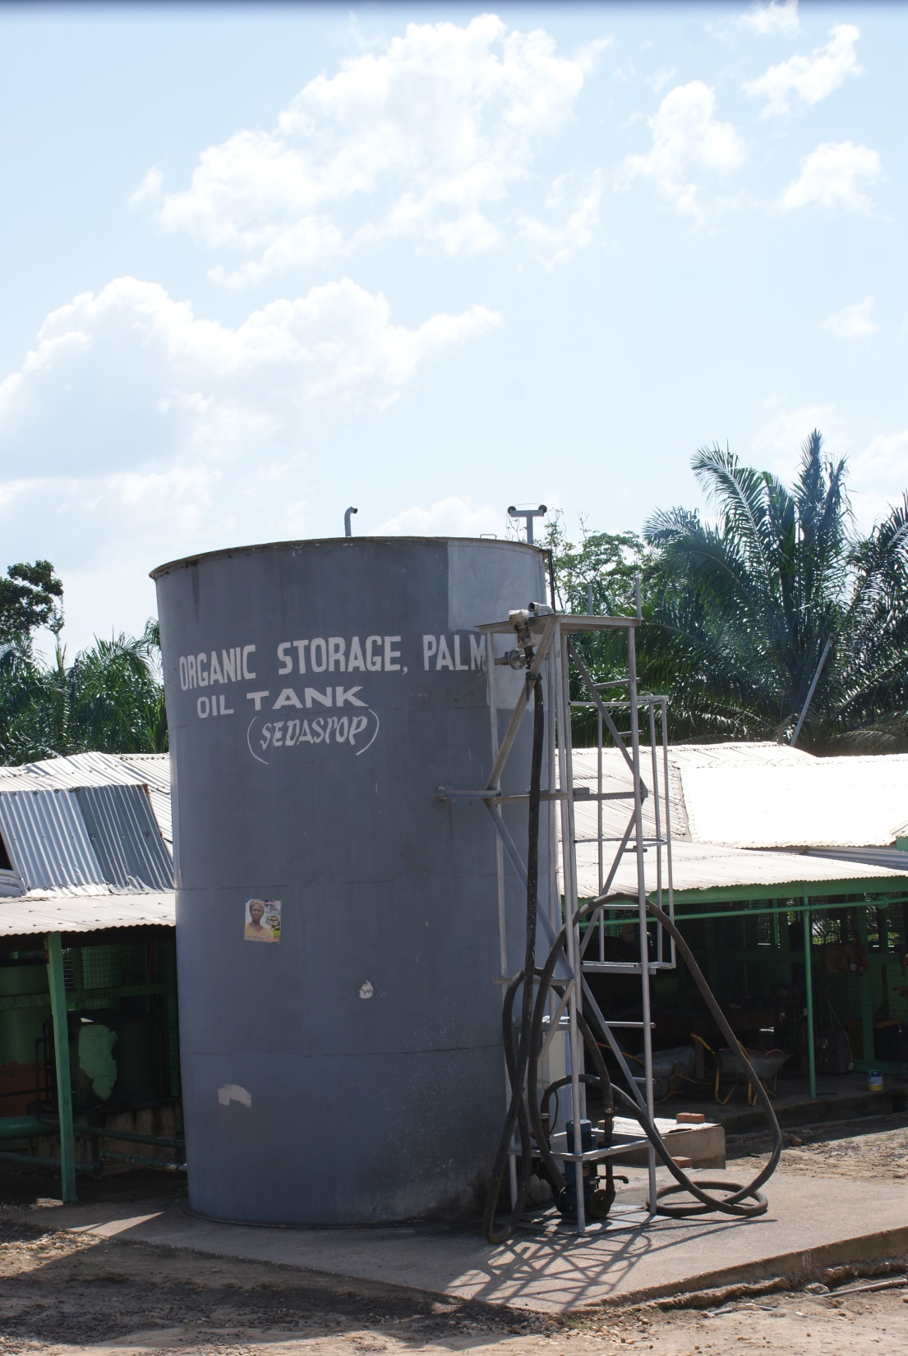
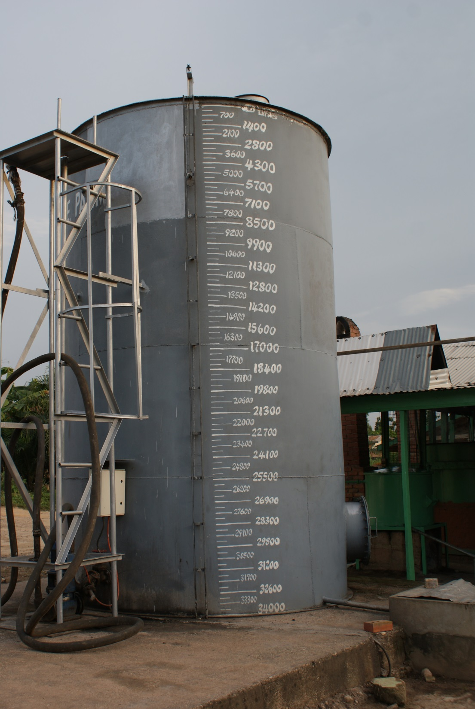

Slide 15
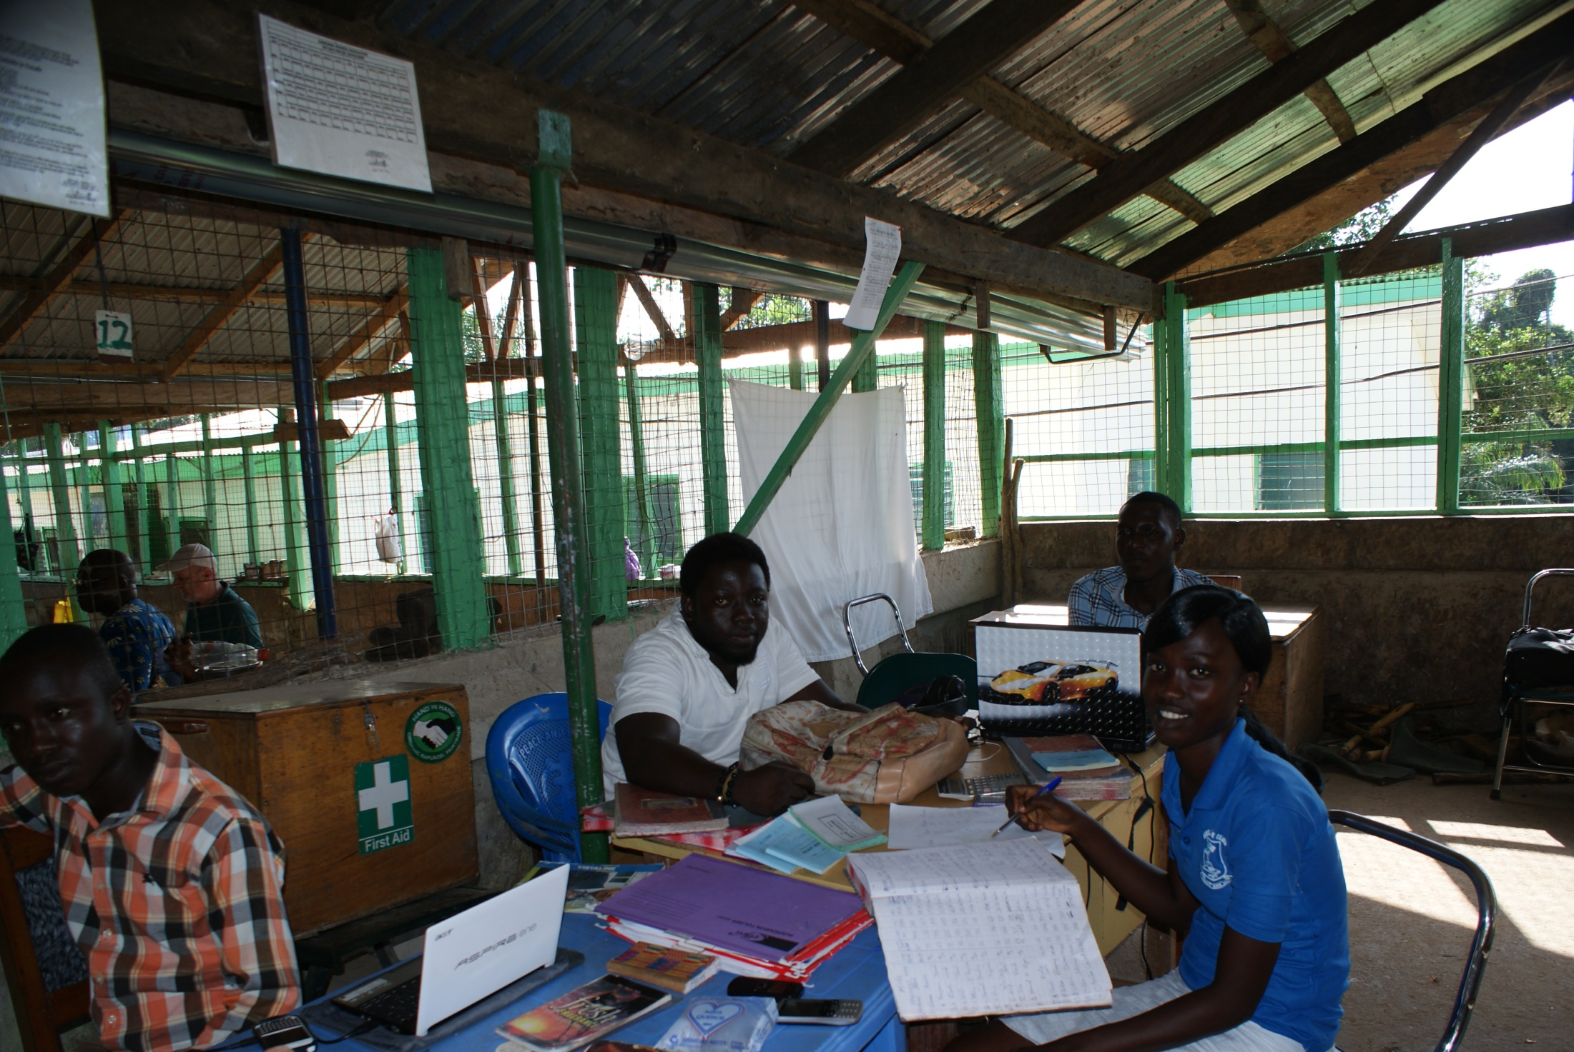

Slide 16
Promotes Sustainability

Slide 17
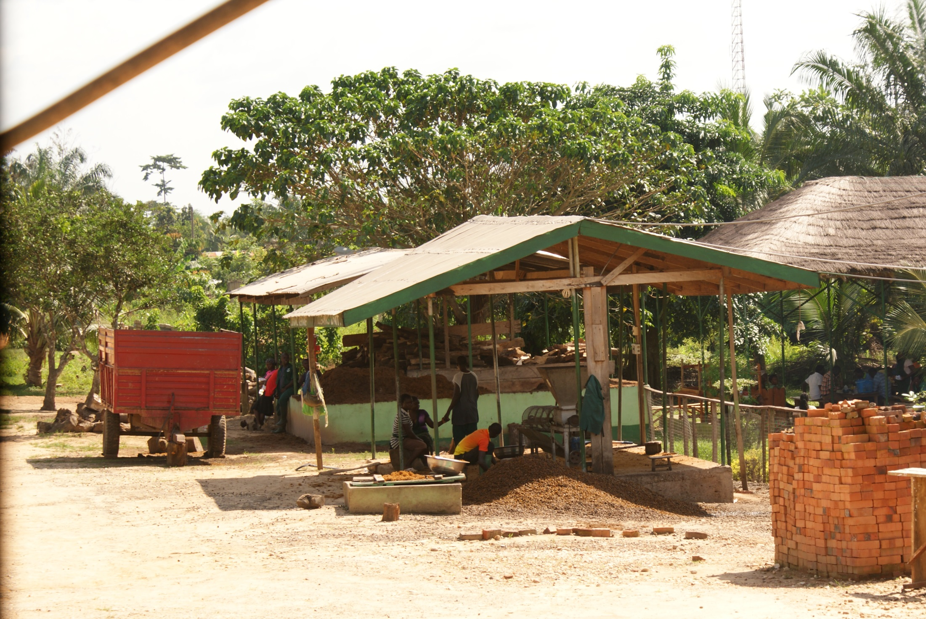

Slide 18
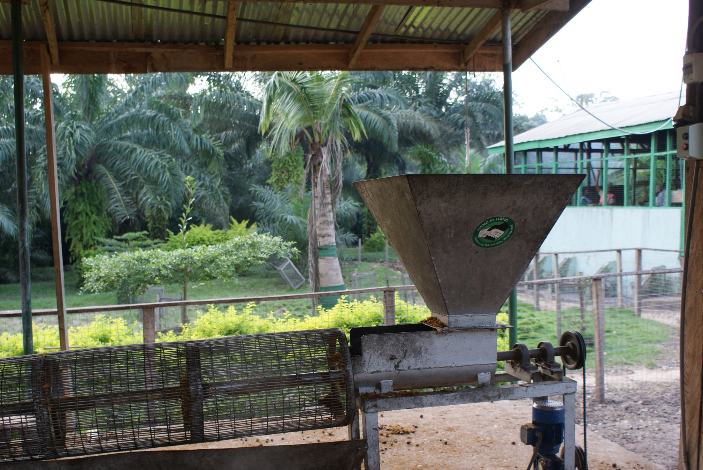

Slide 19
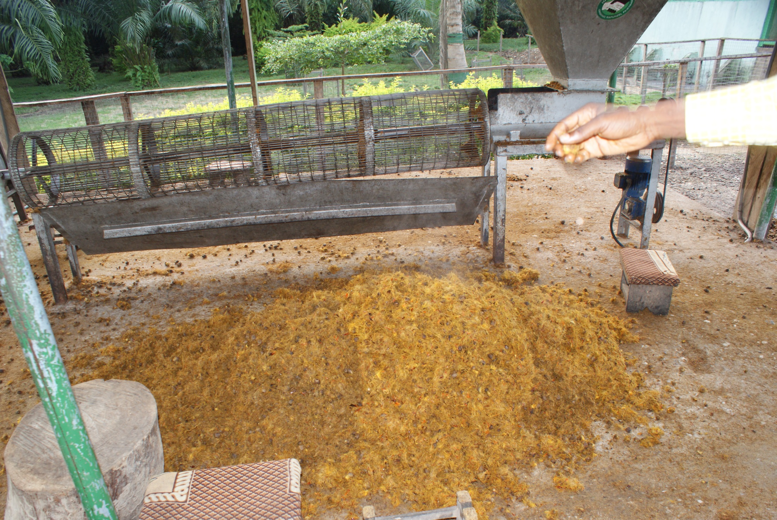

Slide 20
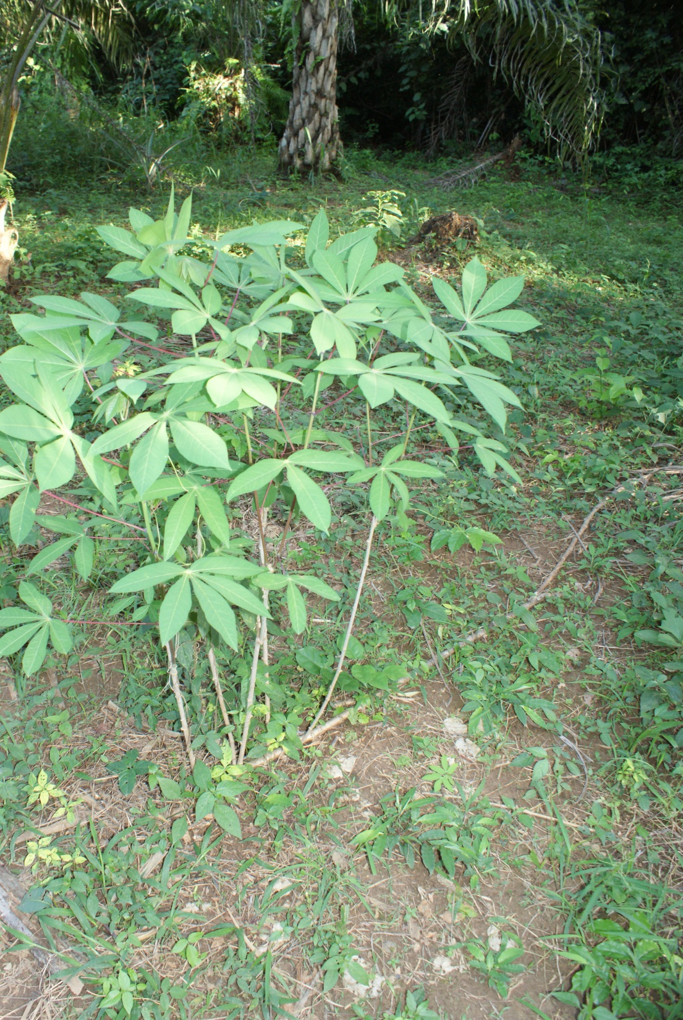
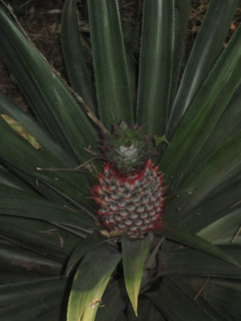

Slide 21
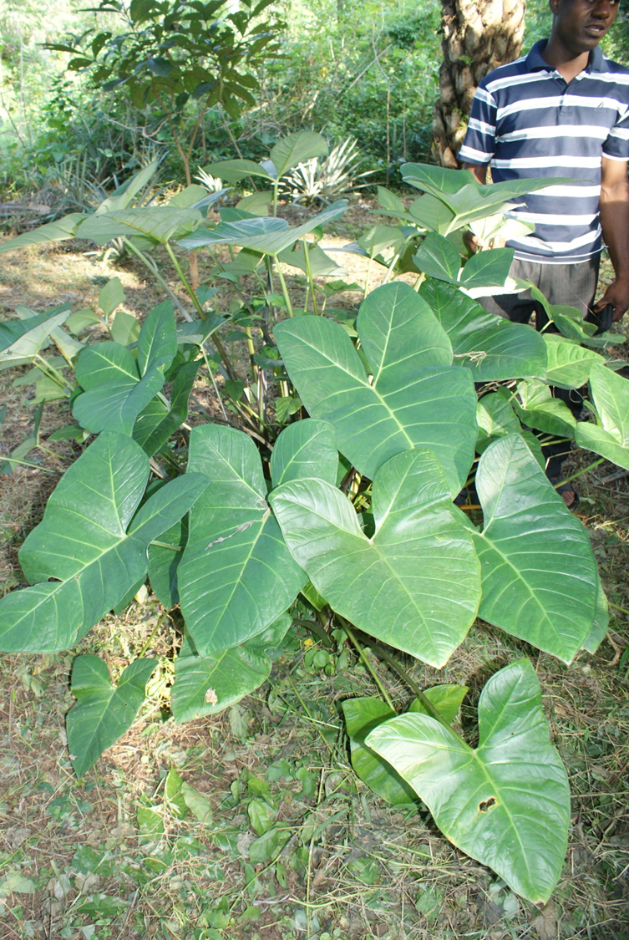
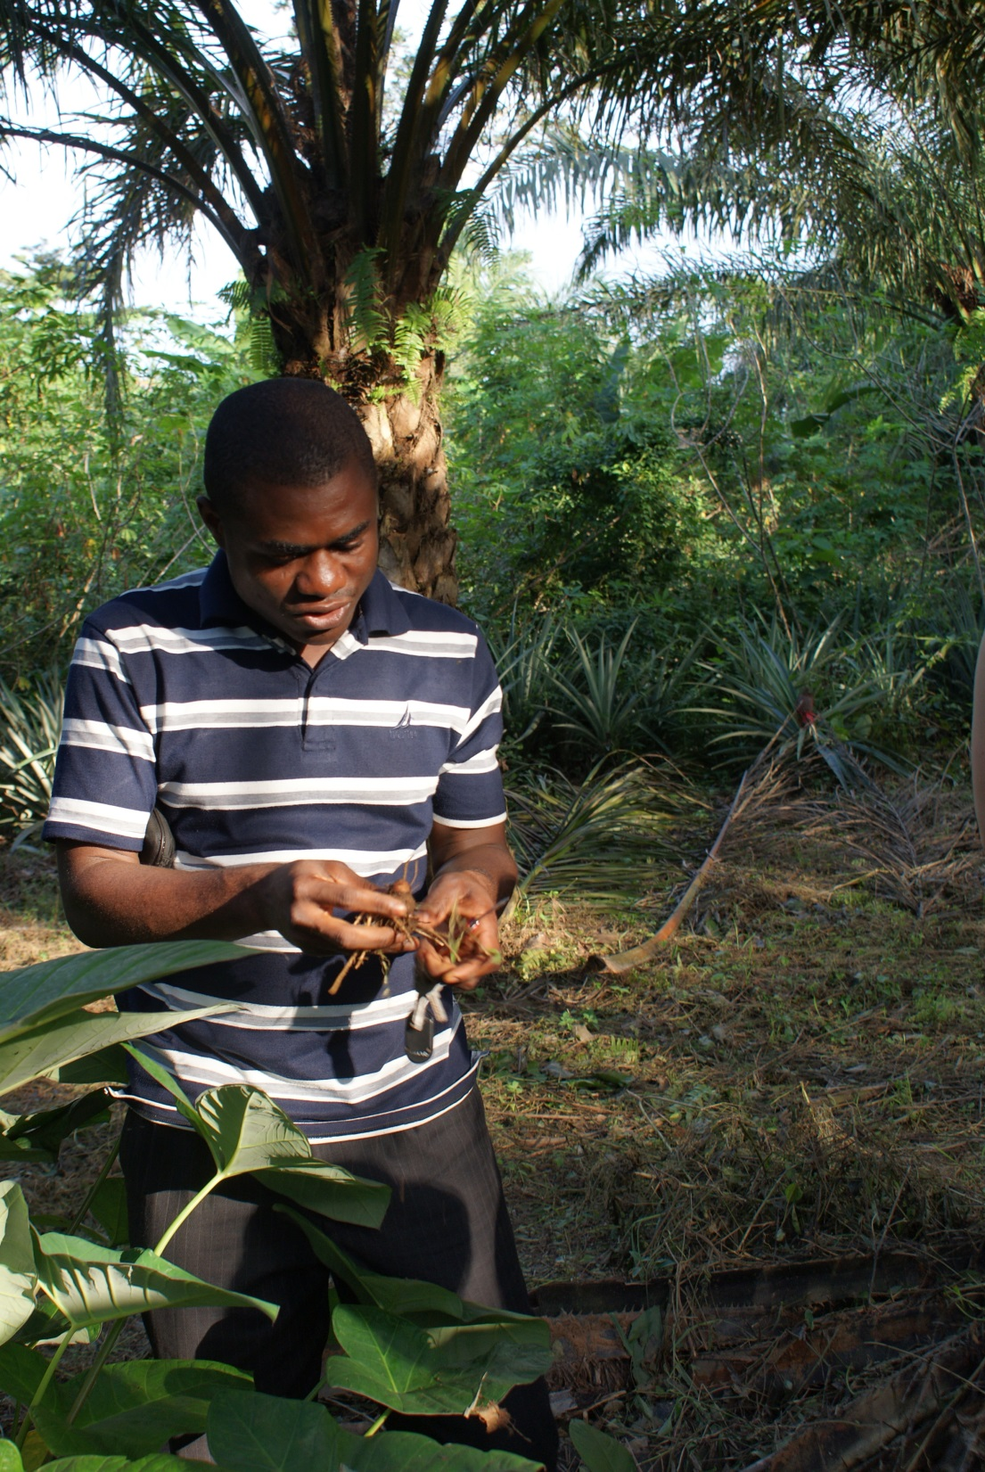

Slide 22
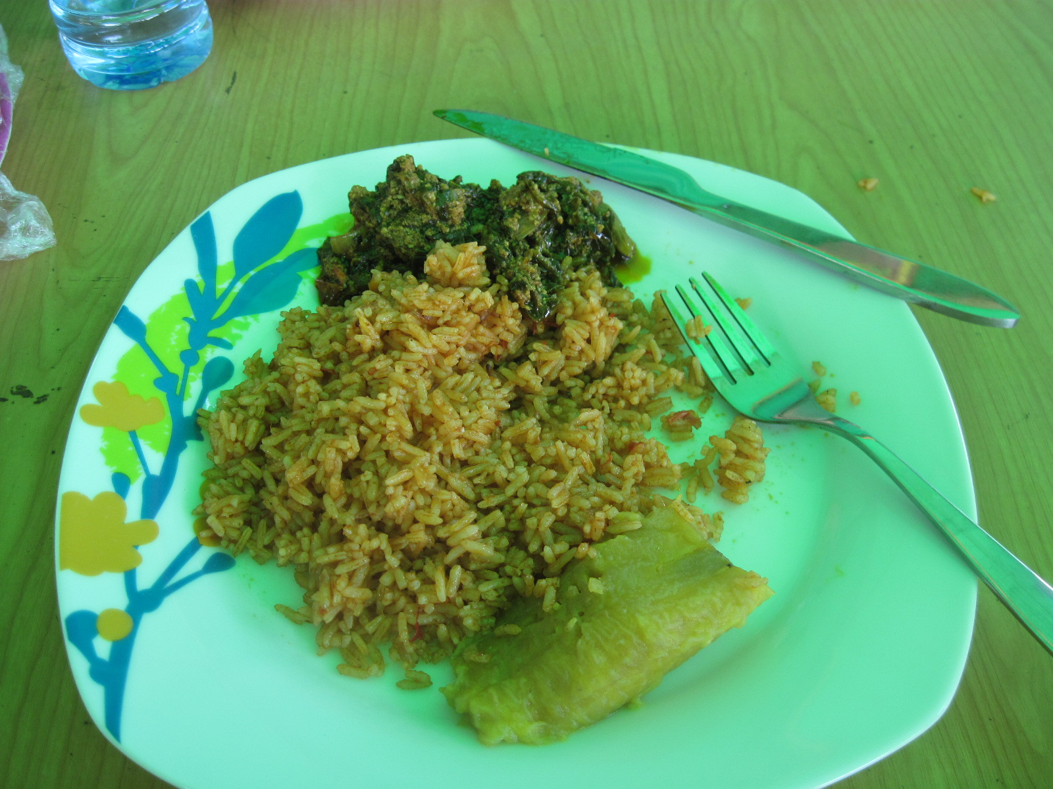

Slide 23
Community Projects

Slide 24
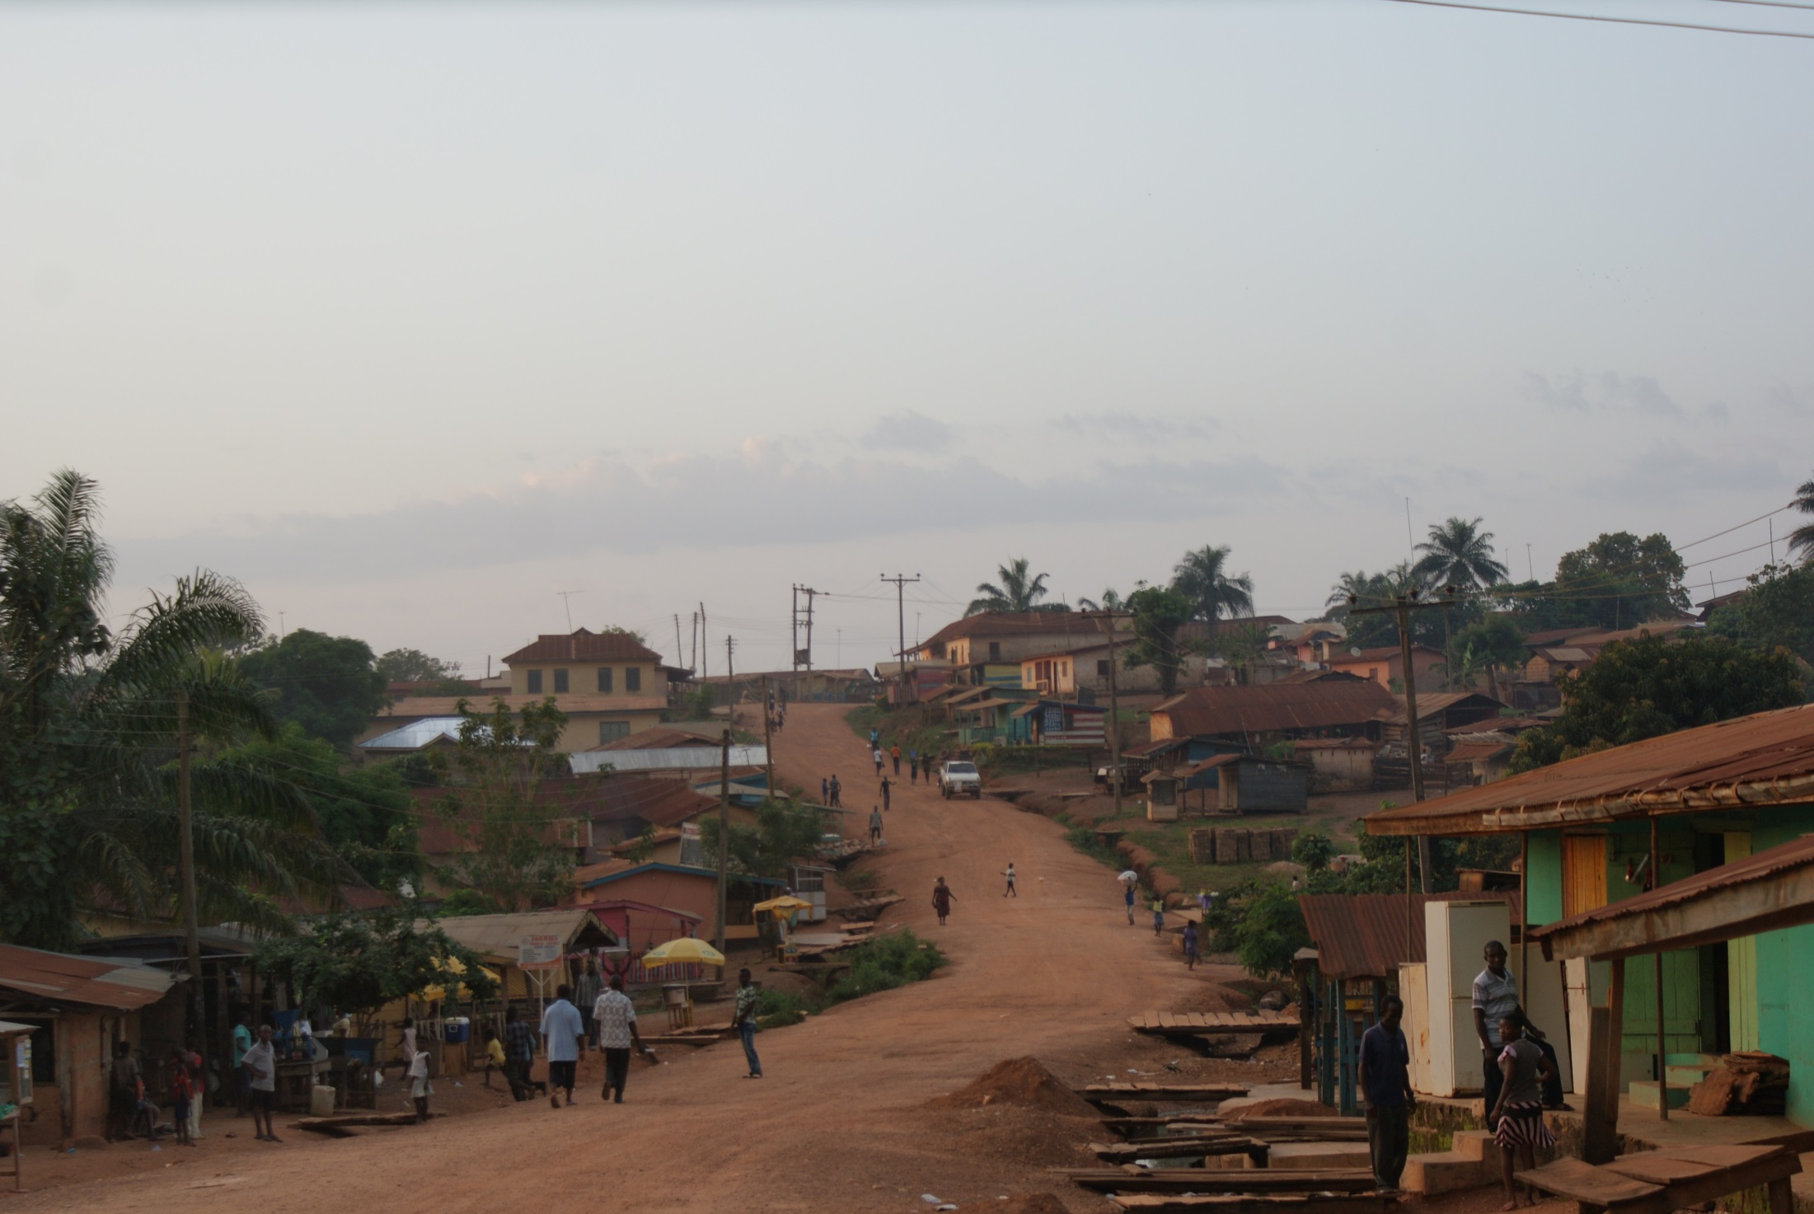

Slide 25
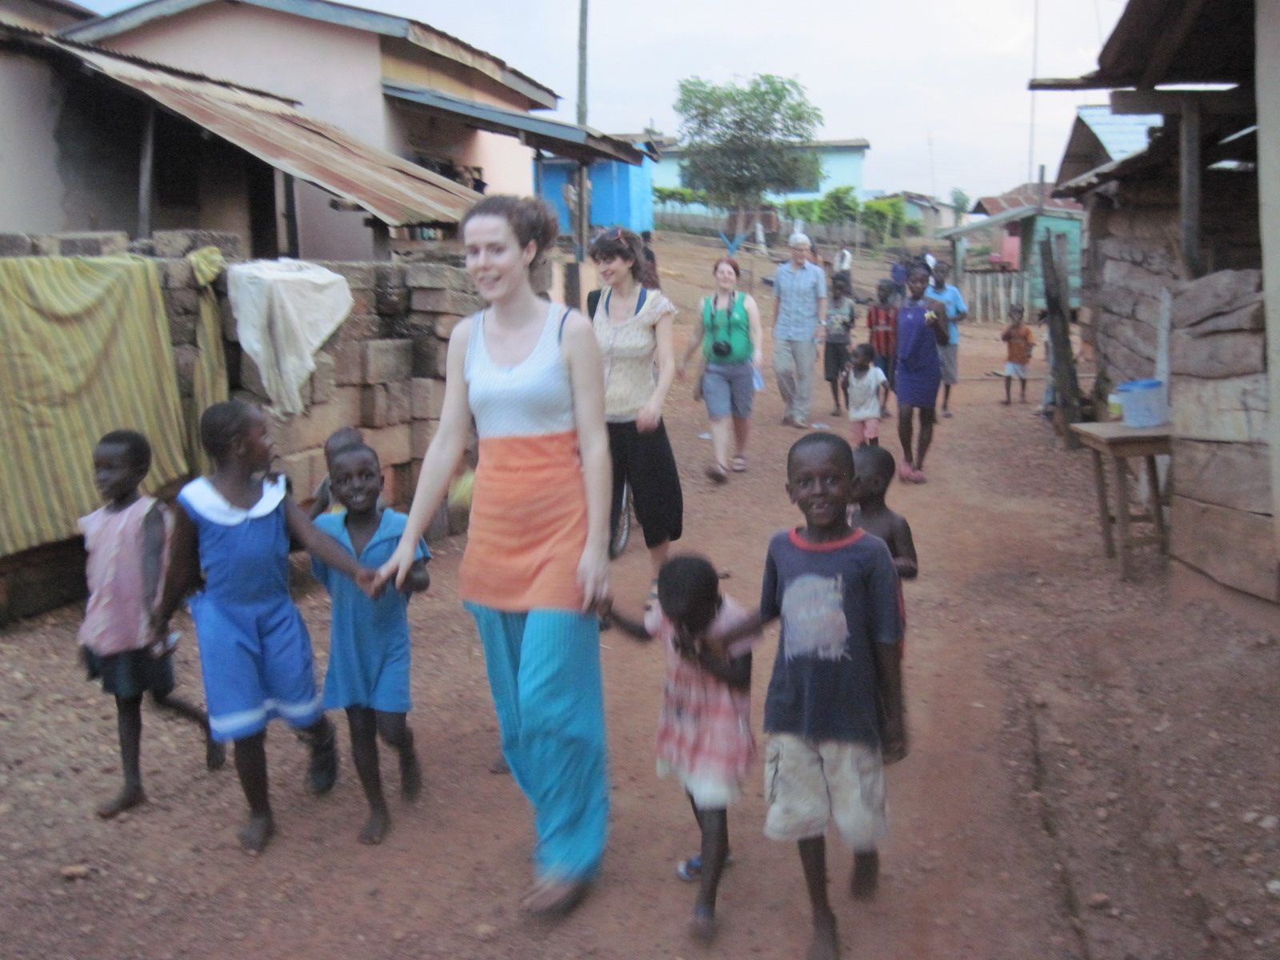

Slide 26
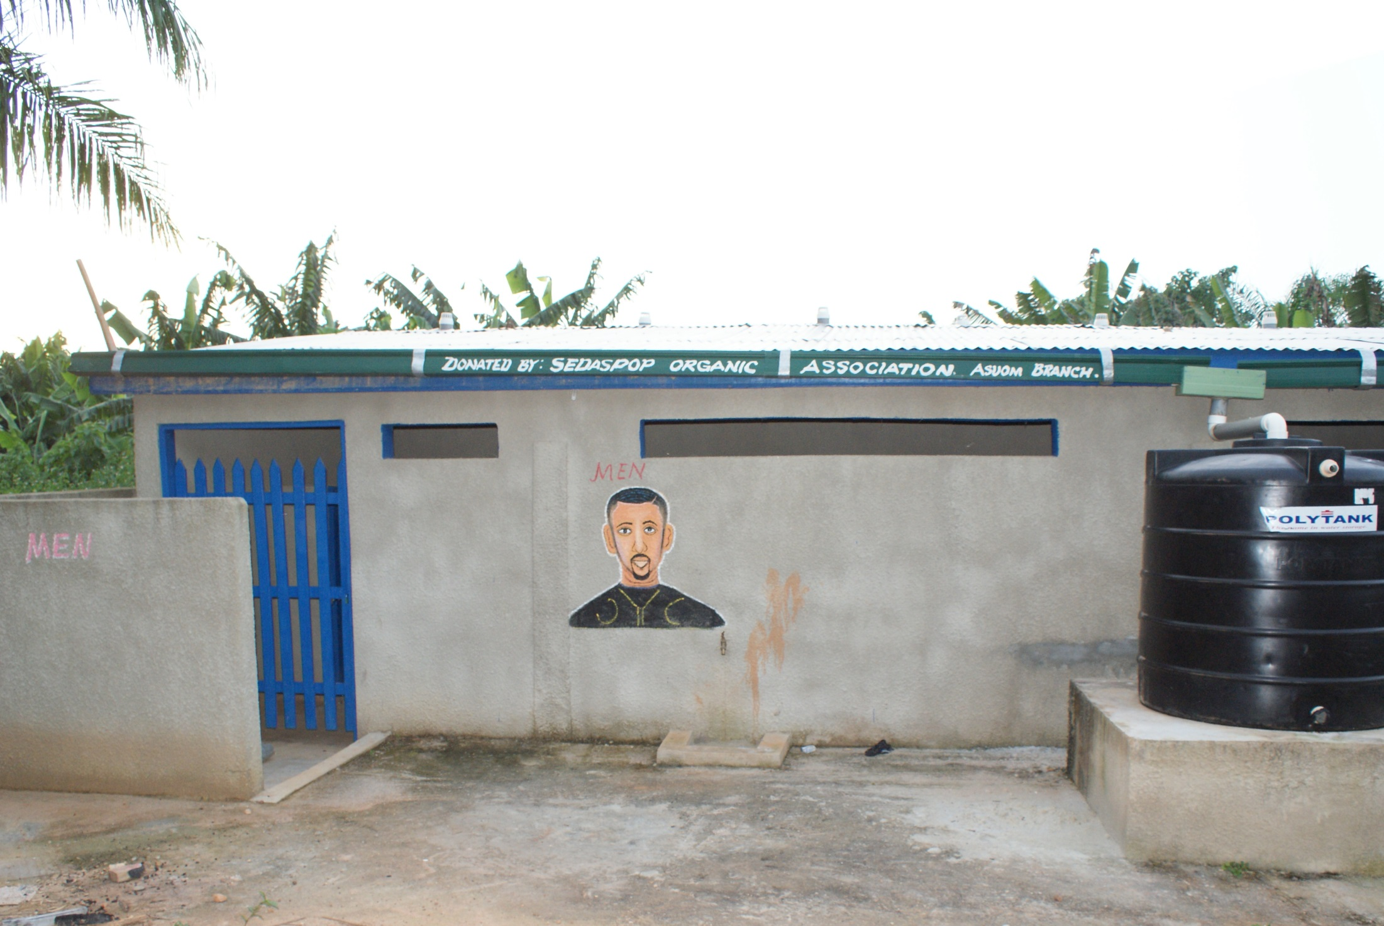

Slide 27
