Slide 1
The Basics

Slide 2
Key Economic Actors
States = countries
Multinational corporations (MNCs)
Prominent individuals
Int’l coalitions
USMCA (fka NAFTA); CPTPP (Comprehensive and Progressive Agreement for Trans-Pacific Partnership)
G20 (‘rich’ + emerging= 85% wealth)
Intergovernmental Organizations (IGOs)
IMF, WTO, EU, WB
Nongovernmental Organizations (NGOs)
Global to local
Aid, policy→ development
¤

Slide 3
Global Divide
Global North
Advanced Industrialized Countries
32 countries

Slide 4
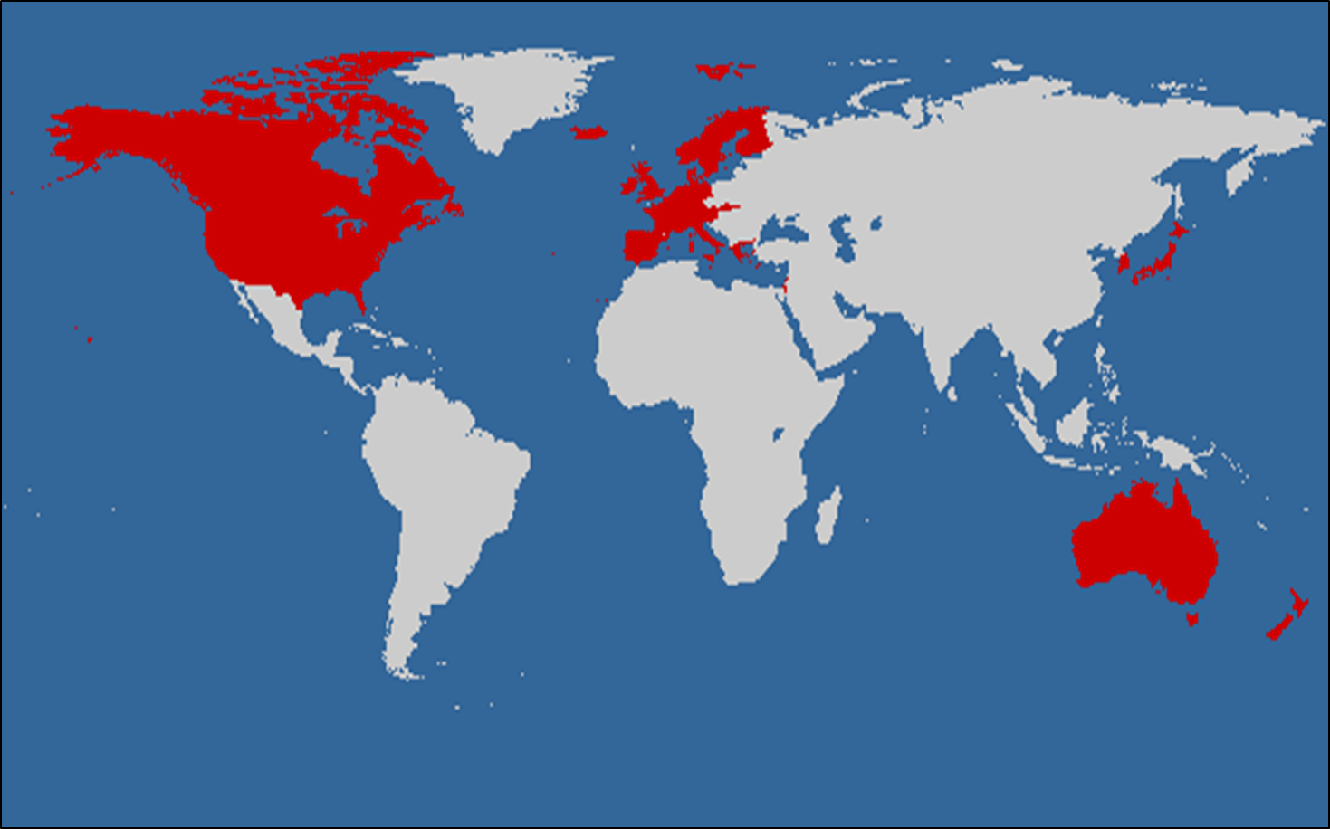
GN Countries

Slide 5
Global Divide
Global North
Advanced Industrialized Countries
32 countries
Global South
162 countries (=83%)
Generic = ‘developing’
Dev. levels vary
¤

Slide 6
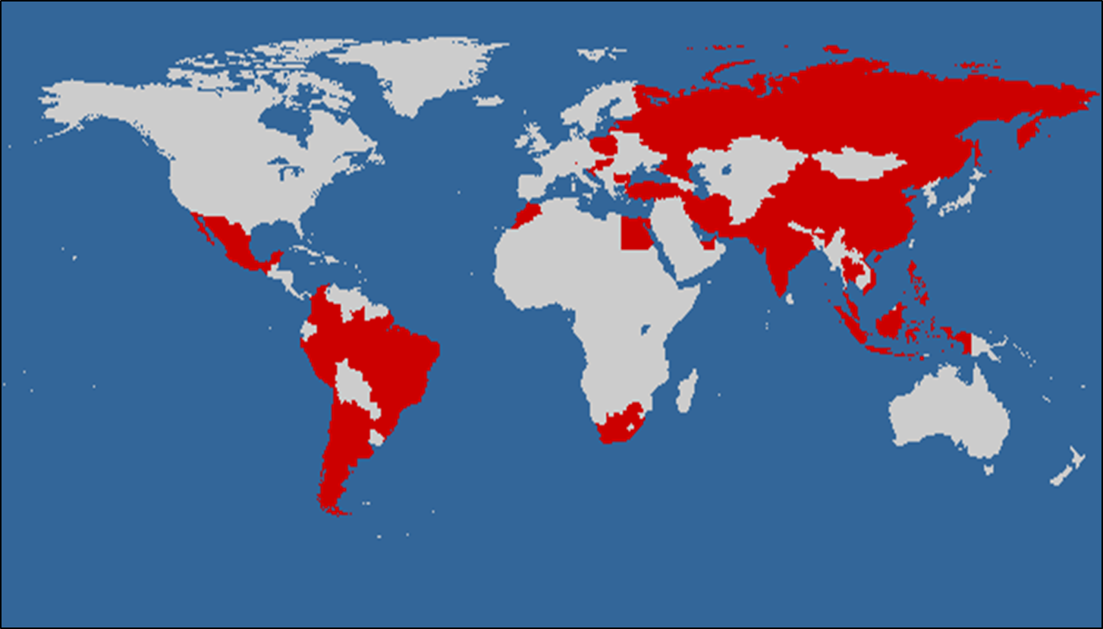
Emerging Economies (EEs)
Upper end of GS
Majority >$10/day

Slide 7
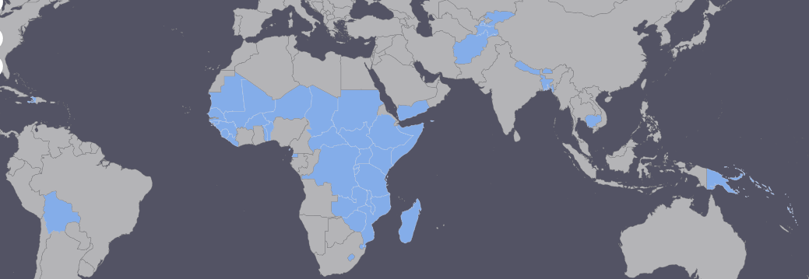
Least Developed Countries
Created using Interactive Map and 2018 IMF data

Slide 8
Income Comparison
Burundi S 4%, I 2%, A 94%
France: S 79%, I 20%, A <2%
Malaysia: S 53%, I 36%, A 11%

Slide 9
IPE
Int’l Monetary System
Int’l Trade System
Int’l Investment & Int’l Finance
Development
Theories
¤

